Slide 1
DOE End-User Training
June 24 – 28, 2024
Department of Energy
Notes:
This training is designed to enable our DOE content contributors to effectively manage your contents for the Energy Portal and its child portals.

Slide 2
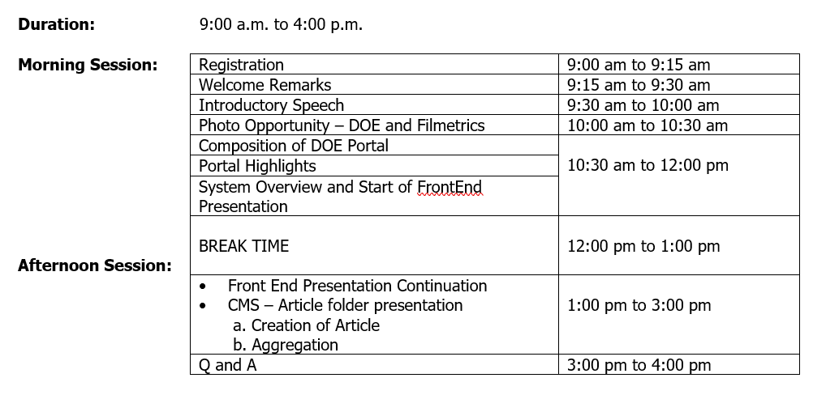
Training Schedule – Day 1 (June 24, 2024)

Slide 3
Training Schedule – Day 2 to Day 5 (June 25-28, 2024)

Slide 4
Agenda
Overview of the DOE Parent and Child Portals
Getting Started with Liferay Content Management System (CMS) platform
Discuss the different features of the Liferay (DOE CMS) Platform
Create and Submit our content in CMS to Reflect in the Portal
Navigate the system!
System Link: https://staging.doe.gov.ph
CMS Link: https://staging-cms2.doe.gov.ph/

Slide 5
Course Outline (Day 1)
1. Front-end
a. Main Navigation
b. Auxiliary Navigation
c. Banner/Featured Videos
d. What's new
e. Online Services
f. General DOE Services
g. Administrative Services (for DOE employees only)
f. Featured Articles
g. Quick links (default and set)
h. Bureaus and Field Offices
2. CMS - Article folder
a. Creation of Article
b. Aggregation

Slide 6
Course Outline (Day 2 to Day 5)
Accessing Liferay
How to Select a Portal to Manage
How to Create a Banner
How to Create an Article
How to Create a Department Circular Content
How to Create a Bid Opportunities Content
How to Create a Key Officials Content
Signing Out
How to Review a Content
How to Approve a Content

Slide 7
House Rules
ACTIVELY PARTICIPATE
BE RESPECTFUL
RAISE YOUR HAND IF YOU HAVE QUESTIONS
STAY FOCUSED
Notes:
In addition to having our training agenda that guides us as participants towards accomplishing our training goals, we need to have first a clear understanding of what is expected of us to best support our activity.
Actively Participate - It will be a pleasure to hear you all answering/asking questions.
Be Respectful - This session is our training ground. It's okay to make mistakes or have many questions in mind during our training. What matters is that we learn.
RAISE YOUR HAND IF YOU HAVE QUESTIONS. - Feel free to ask questions. They are welcome here. You may use the virtual raise hand and/or the chat box.
Stay Focused

Slide 8
Objectives
At the end of this session, you are expected to:
Know how to navigate Liferay
Know how to create and display your content to your portal
Know how to access Knowledge Base

Slide 9
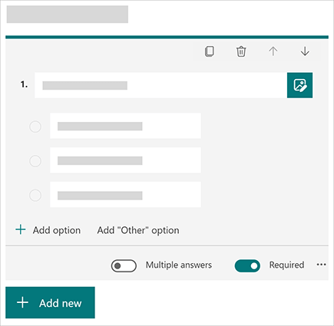
Training Evaluation
Self-Assessment Form
Training Experience Survey Form
Notes:
For us to evaluate if we meet our objectives, we will be providing you with a copy of the Self-Assessment Form. The results of that assessment will not be shared with all the participants in this call but rather we will use it for assessing if we are already ready to use the system.
Aside from that (this one is optional), we will be collecting your feedback about how effective our training is.

Slide 10
PART I

Slide 11
GETTING STARTED

Slide 12
What is Content Management System?
A Content Management System (CMS) is a software application that enables users to create, edit, collaborate on, publish and store portal content. In essence, every file that is created and stored as part of a website in the form of pages, images, logos or text contents are categorized. Content Management is a system that gives rights to others or a particular section within an organization to manage the portal.
Notes:
Rather than developing and building a system that can help in the creation of web pages or store images, CMS can be useful for handling all types of infrastructure work, while you or our ITMS team can concentrate on the consumer-facing areas of the Energy Portal.
In short, our Energy Portal is a website that is developed by using a content management system.

Slide 13
What is a CMS Portal?
Your own requirements and terms
No coding knowledge is required
Simplifies the redesigning of the portal contents
Multiple Access and Collaboration
Portal Security
Cost and Time-saving maintenance
Notes:
What is the use of CMS?
There a number of advantages of CMS, let us look at a few of them:
Updating your Energy Portal as per your own requirements and terms
So let us say your portal is managed or developed by a third-party developer or managed by your IT group, you will need to contact them for each and every small or big change you need to make to your website.
For example, if you want to add images or update about a new event, you will have to ask them to do it for you. Instead of going to the developer for each and every small thing, a CMS website helps you to get rid of this to and from the business.
Your portal can be updated and managed easily by you, without having to depend on a third person. A CMS enables you in making your portal updated, more dynamic and more interesting and useful to your visitors.
No Coding knowledge required
Content management systems are a boon to users who do not have any coding knowledge. They were specifically built keeping in mind users having little to no previous programming experience.
Once your portal is completely developed, you can manage the content on the website easily with a CMS.
The CMS comes with a WYSIWYG editor (What You See Is What You Get), which helps you to manage and edit web content, like images and text on the portal.
It is as simple as creating a document on Microsoft Word. CMS is very useful in creating web pages, blog posts, news articles etc. on the website.
3. Simplifies the redesigning of the web contents
Portals/Websites developed with support from content management system have their designs created separately from the content.
Therefore, in case you want to redesign the portal or make some design-specific changes, you can do so without having rehauled the complete portal. The old design can be easily replaced with a new design in a CMS website. Or you can also create a new portal if there would be any future requirement.
4. Multiple Access and Collaboration
A CMS allows a number of people to have easy access to the portal and also collaborate on different projects while working on it.
Individuals can create their own accounts and by logging through these individual accounts, multiple users can manage, edit or update content on the portal from their own computers or devices.
The CMS helps in storing all the online content and making it available to everyone who has access to the portal. This means you no longer will need to send files multiple times to different individuals.
Content management systems are extremely convenient for people who are always on-the-go, people who would need to access the back-end of the website from different locations.
5. Portal Security
Today it is very important that your website is secure and cannot be hacked. Especially in this fast-growing online world, it is important for website owners to ensure that their portal is safe and secure.
Liferay CMS are regularly tested by computer scientists to ensure that the websites are completely secure. There are a number of plugins and tools also which are available which can be used to increase the website’s security.
6. Time-saving Maintenance
Maintaining a static website is expensive. You need a web developer to frequently update and make changes to maintain it.
Other than the cost involved, it also takes some time for the updates to be seen on the website. Choosing a content management system can help you save both time and money.
Thanks to a CMS you may not have to be dependent on a developer to make some common changes or for maintaining it. CMS is so easy to work, one can easily make these changes when the need arises.
Conclusion
As we discussed there are many advantages of CMS, and they are very useful. Different CMS have different features, and you can select the best CMS for your website depending on your requirement.

Slide 14
How CMS Works
Energy Portal
Admin / Content Managers
Full Rights
Site Visitors
Content Publishers/
Contributors
Limited Rights
Editors
Moderate Rights
Approvers
Moderate Rights
Notes:
In general, a CMS (Content Management System) consists of two elements: the content management application (Content Management Application, [CMA]) content delivery application (Content Delivery Application [CDA]). The CMA element allows the content manager may not have knowledge of HTML, to manage the creation, modification, and deletion of content from a Web site without the need to have expertise as a Webmaster.

Slide 15
ENERGY PORTAL

Slide 16
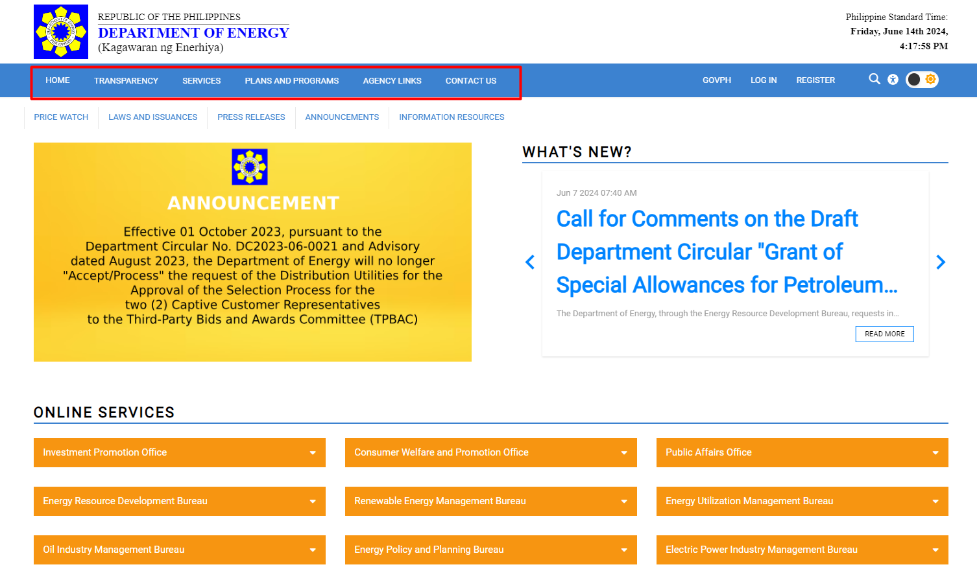
Main Menu

Slide 17
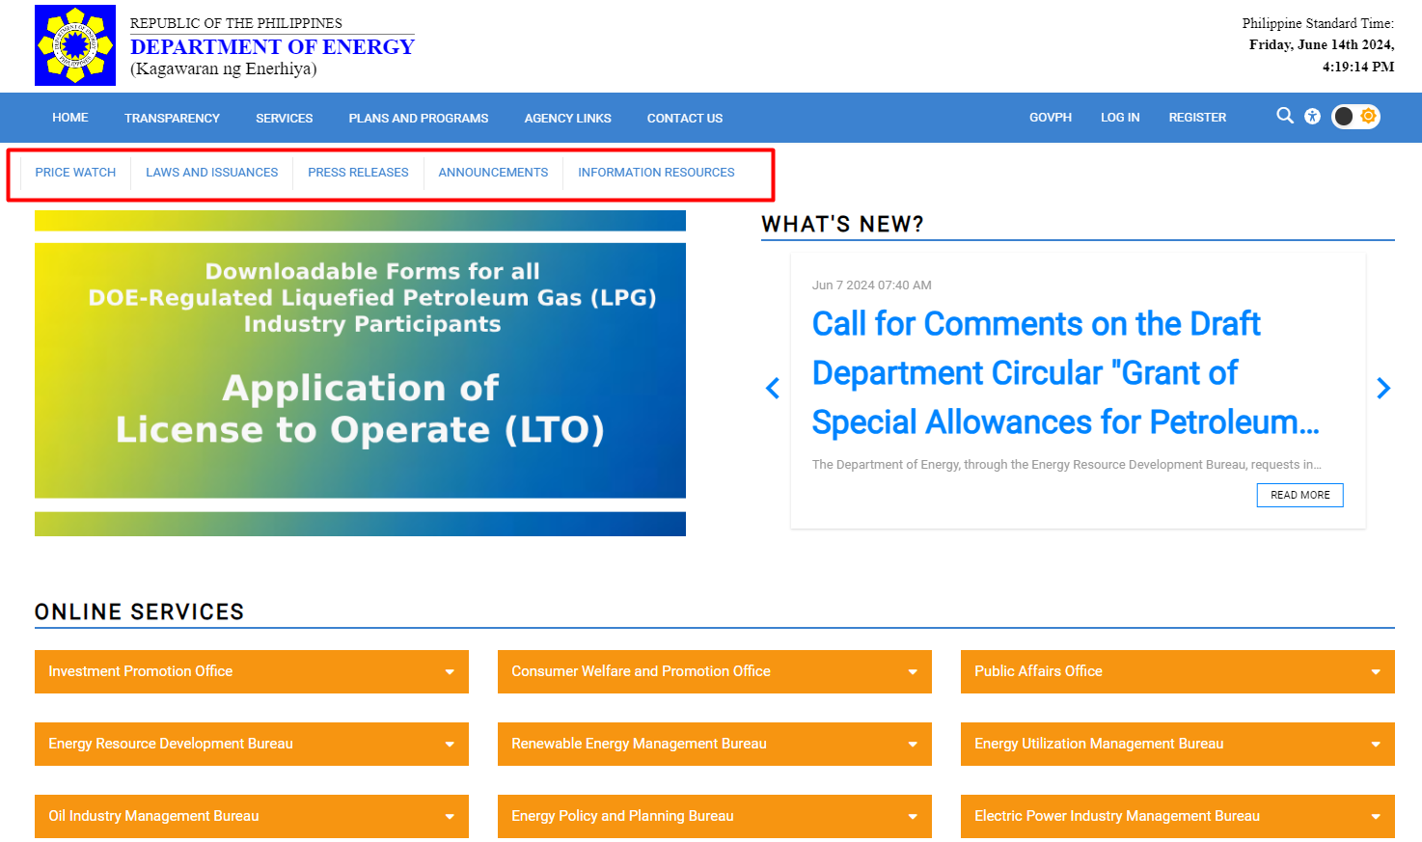
Auxiliary Menu

Slide 18
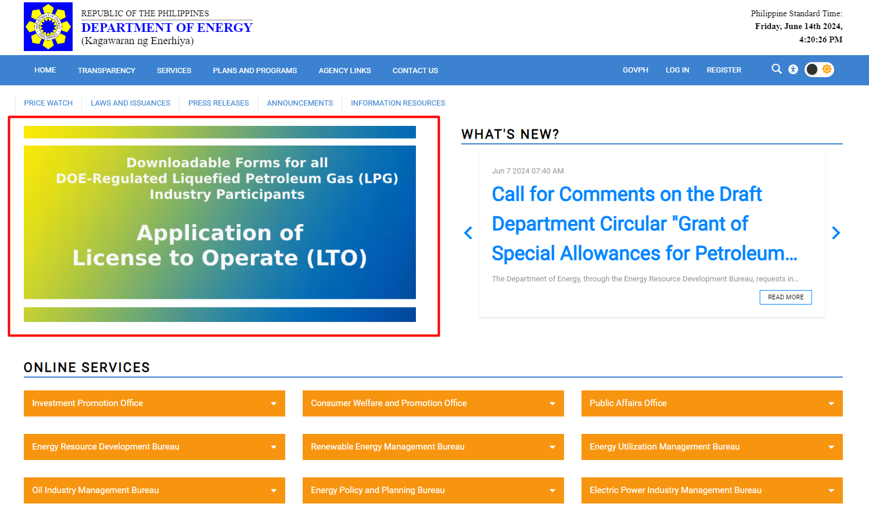
Banner or Featured Photos/Videos

Slide 19
What’s New
Notes:
10 Most Recent Approved Articles

Slide 20
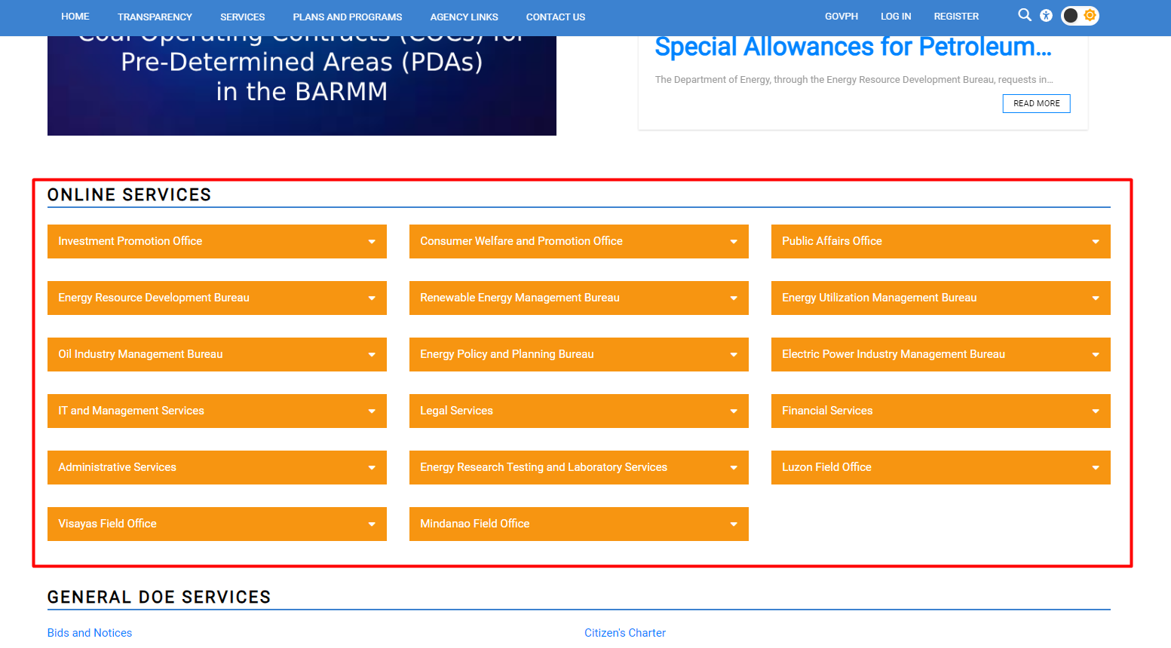
Online Services

Slide 21
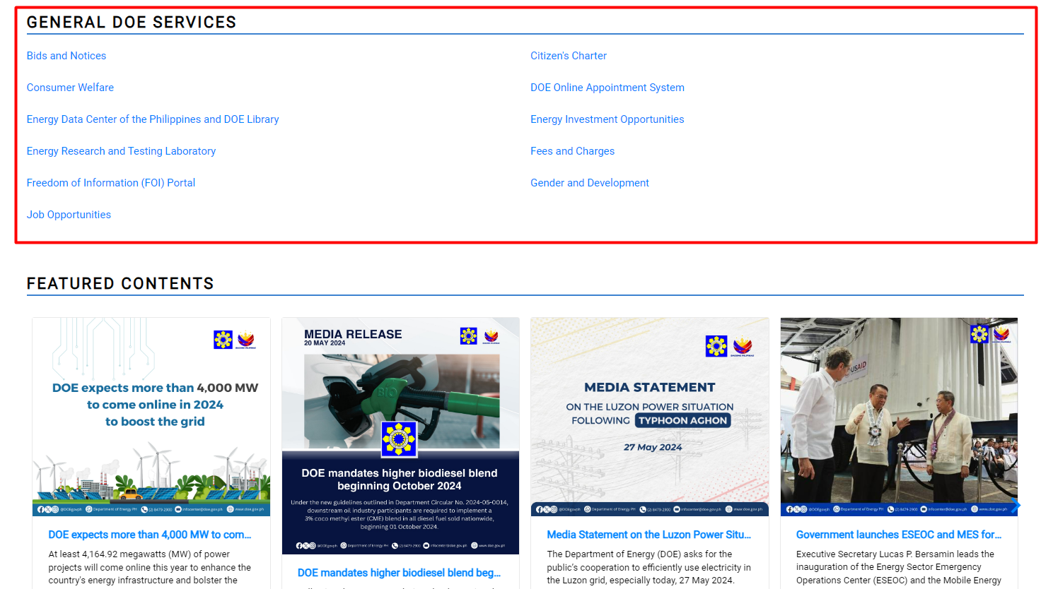
General DOE Services

Slide 22
Internal Services

Slide 23
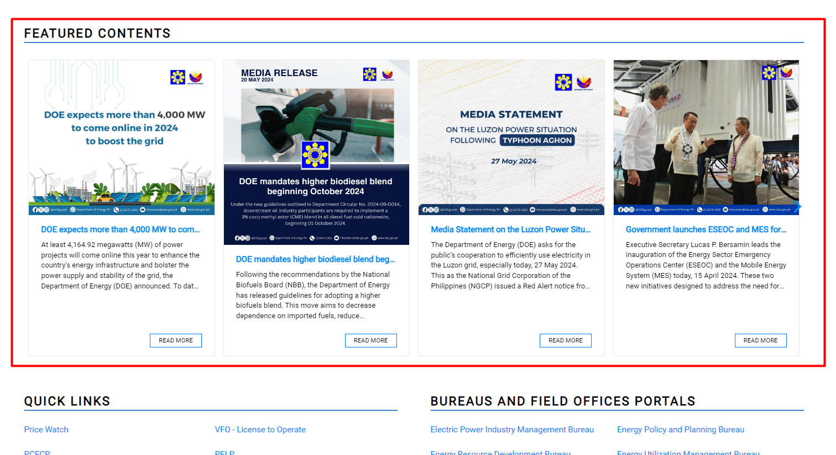
Featured Contents or Featured Articles

Slide 24
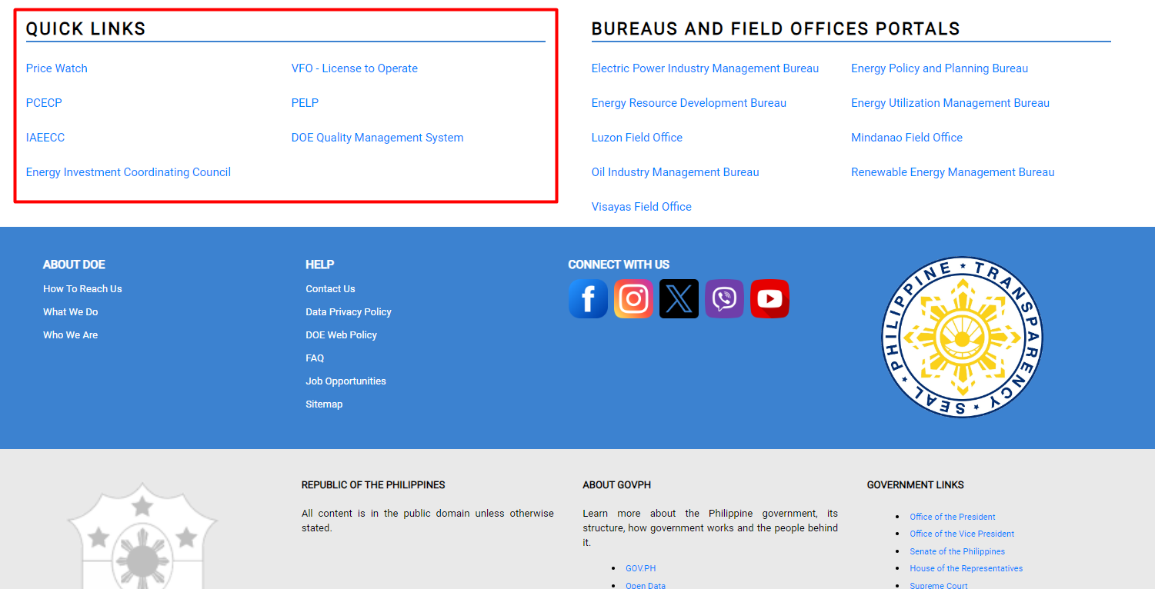
Quick Links

Slide 25
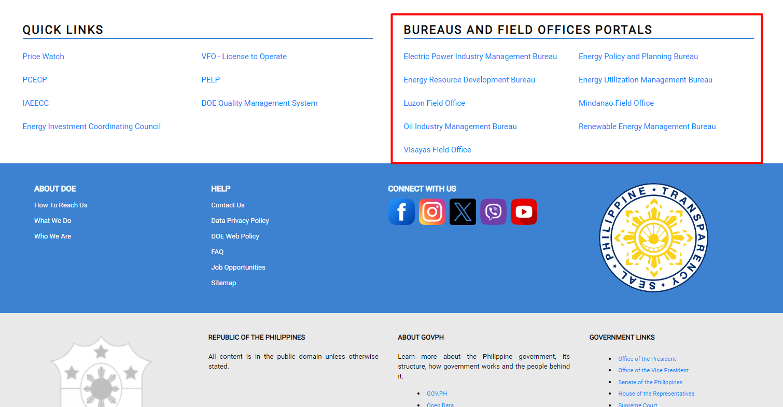
Bureaus and Field Offices Portals

Slide 26
LIFERAY DXP

Slide 27
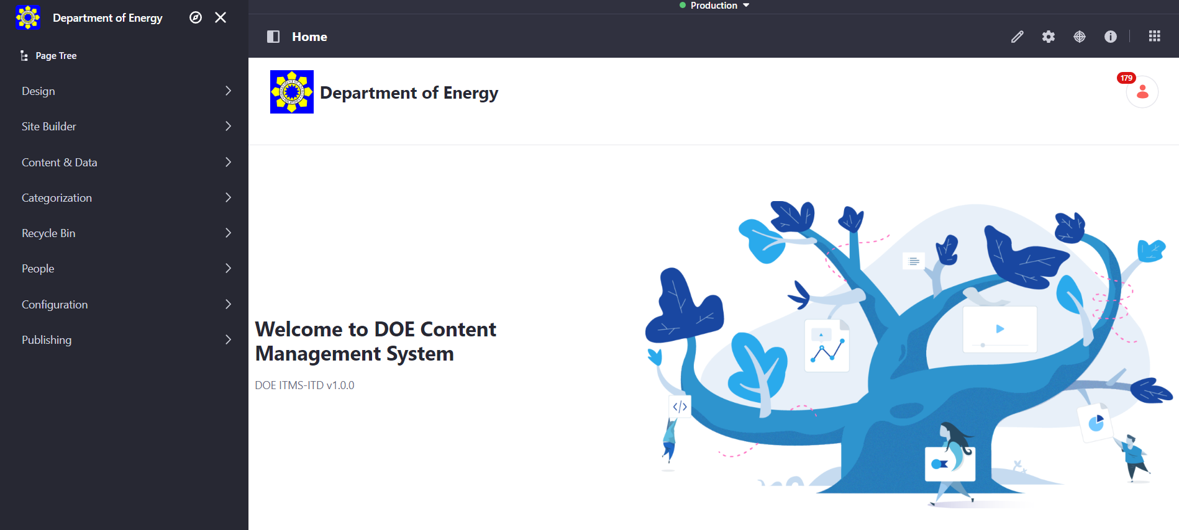
Liferay DXP
Liferay DXP is a powerful and enterprise-ready platform for building and deploying web applications and content. With Liferay Objects, you can build and deliver applications and content without having to write code or deploy modules.
Notes:
Liferay DXP is a powerful and enterprise-ready platform for building and deploying web applications and content. However, all of that power and functionality can make it difficult to know where to start. This section walks you through some of the basics of getting an instance up and running on your own local machine, explains the Liferay user interface, and get you started with creating your first site.

Slide 28
End-User Account

Slide 29
End-User Account
The End-User account is created by the Portal Administrator who has full permissions to modify every facet of a DOE Portal instance.
The End-User has three roles. The Portal Content Creator, Portal Content Reviewer and Portal Content Approver.
Portal Content Creator can only create, modify and submit contents for approval. While the Portal Content Review and Approver can update and approve the submitted content for approval.

Slide 30
PART II

Slide 31
Portal Content Creator

Slide 32
Accessing Liferay
Open a browser to https://staging-cms2.doe.gov.ph
Click the Sign In link
Enter the provided credentials to login.

Slide 33
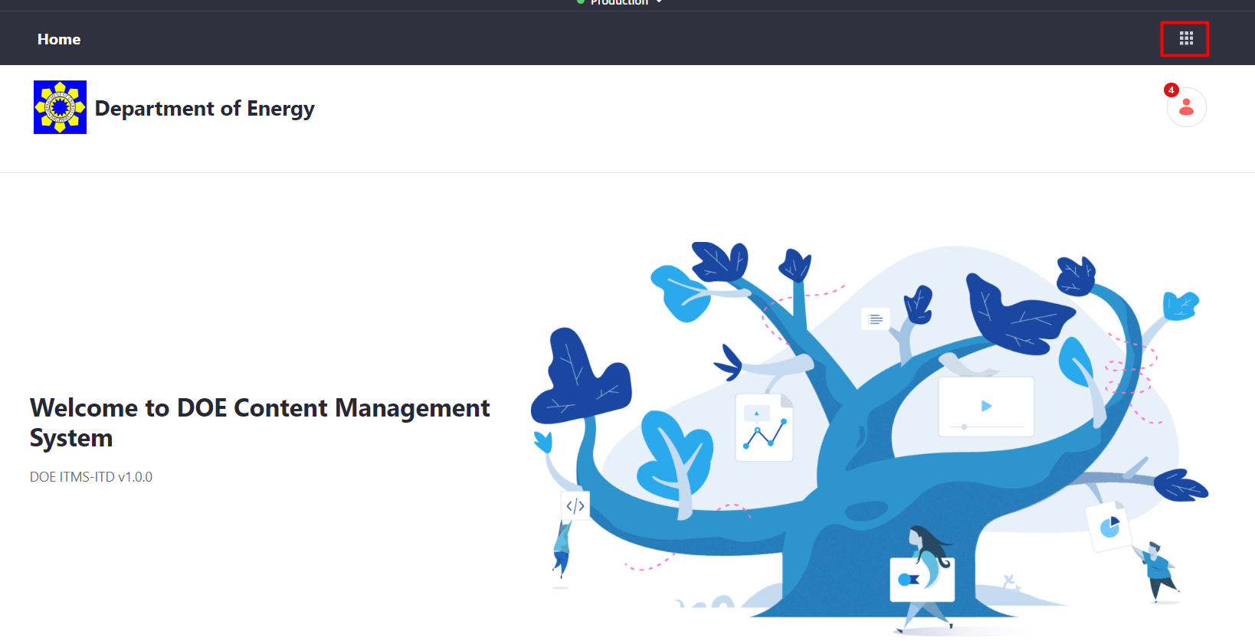
How to Select a Portal to Manage
1. Click the chocolate icon.

Slide 34
How to Select a Portal to Manage
2. Click the site you want to manage.

Slide 35
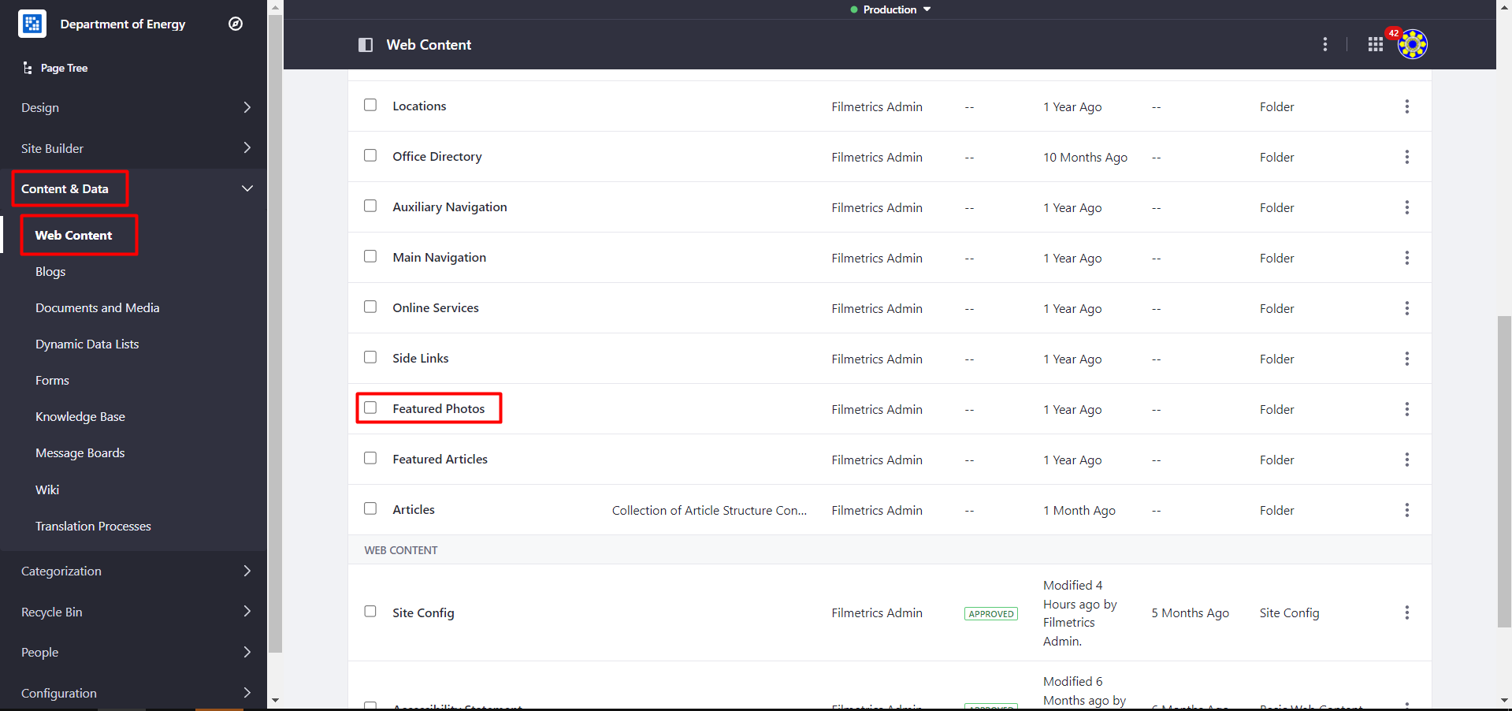
How to Create a Banner
1. Go to Content & Data > Web Content and Featured Photos Folder.

Slide 36
How to Create a Banner
2. Click + button (click More if not on the initial list) and Select Link to Featured Photo, and fill-up the required fields.
Notes:
Click + button (click More if not on the initial list) and Select Link to Featured Photo, and fill-up the following:
Content Name
Select Photo (NOTE: Photos should be selected under Documents and Media)
Optional: Provide Read More Link or Register Link if applicable. The link provided should be a valid URL. E.g., https://www.doe.gov.ph

Slide 37
How to Create a Banner
2. Click + button (click More if not on the initial list) and Select Link to Featured Photo, and fill-up the required fields.
Notes:
Click + button (click More if not on the initial list) and Select Link to Featured Photo, and fill-up the following:
Content Name
Select Photo (NOTE: Photos should be selected under Documents and Media)
Optional: Provide Read More Link or Register Link if applicable. The link provided should be a valid URL. E.g., https://www.doe.gov.ph

Slide 38
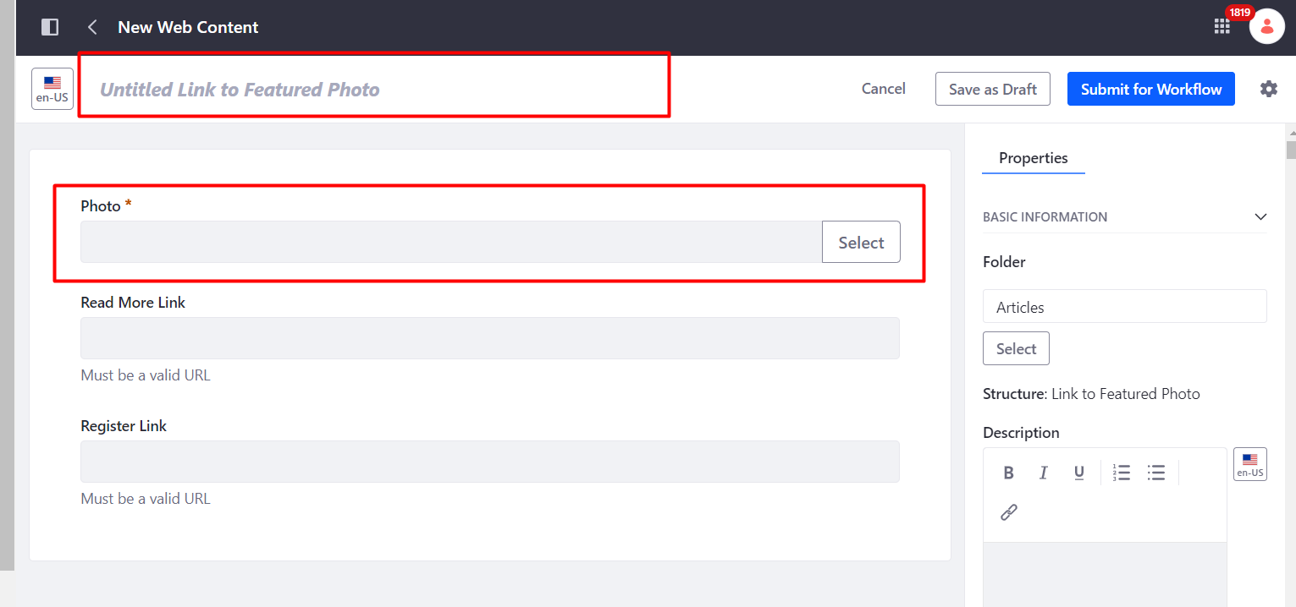
How to Create a Banner
2. Click + button (click More if not on the initial list) and Select Link to Featured Photo, and fill-up the required fields.
Notes:
Click + button (click More if not on the initial list) and Select Link to Featured Photo, and fill-up the following:
Content Name
Select Photo (NOTE: Photos should be selected under Documents and Media)
Optional: Provide Read More Link or Register Link if applicable. The link provided should be a valid URL. E.g., https://www.doe.gov.ph

Slide 39
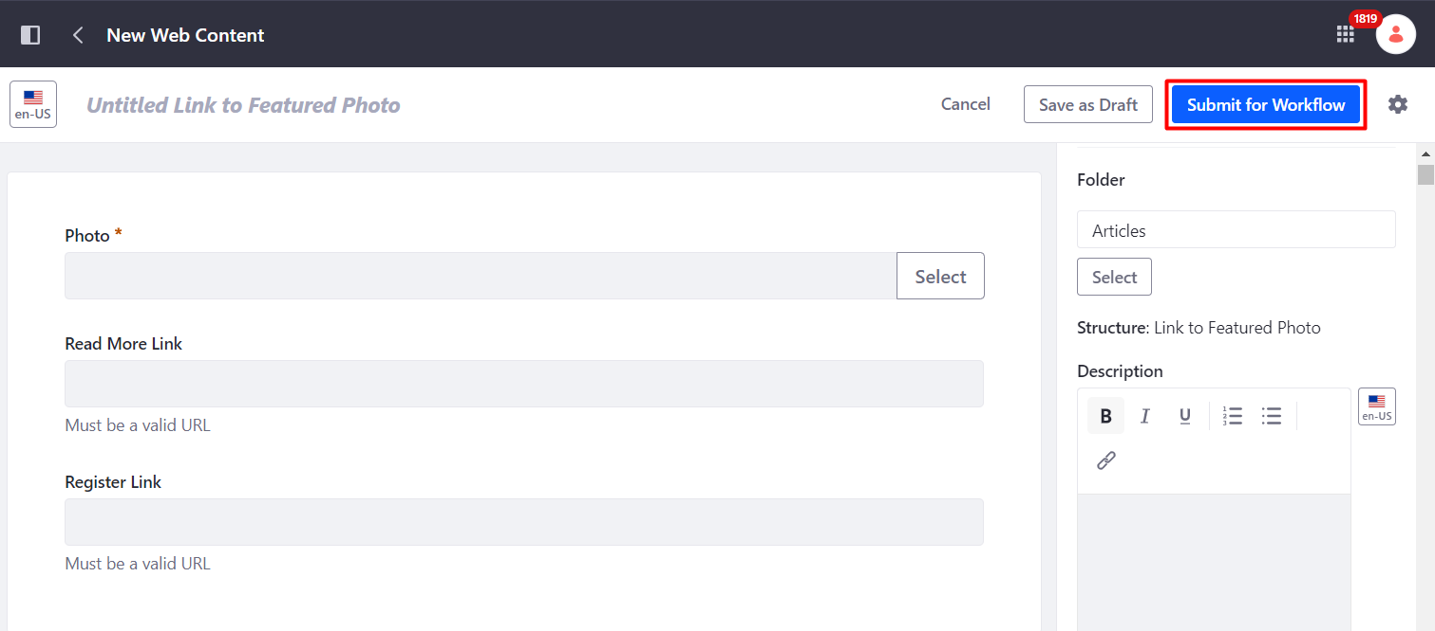
How to Create a Banner
3. Click Submit for Workflow.
Notes:
Click + button (click More if not on the initial list) and Select Link to Featured Photo, and fill-up the following:
Content Name
Select Photo (NOTE: Photos should be selected under Documents and Media)
Optional: Provide Read More Link or Register Link if applicable. The link provided should be a valid URL. E.g., https://www.doe.gov.ph

Slide 40
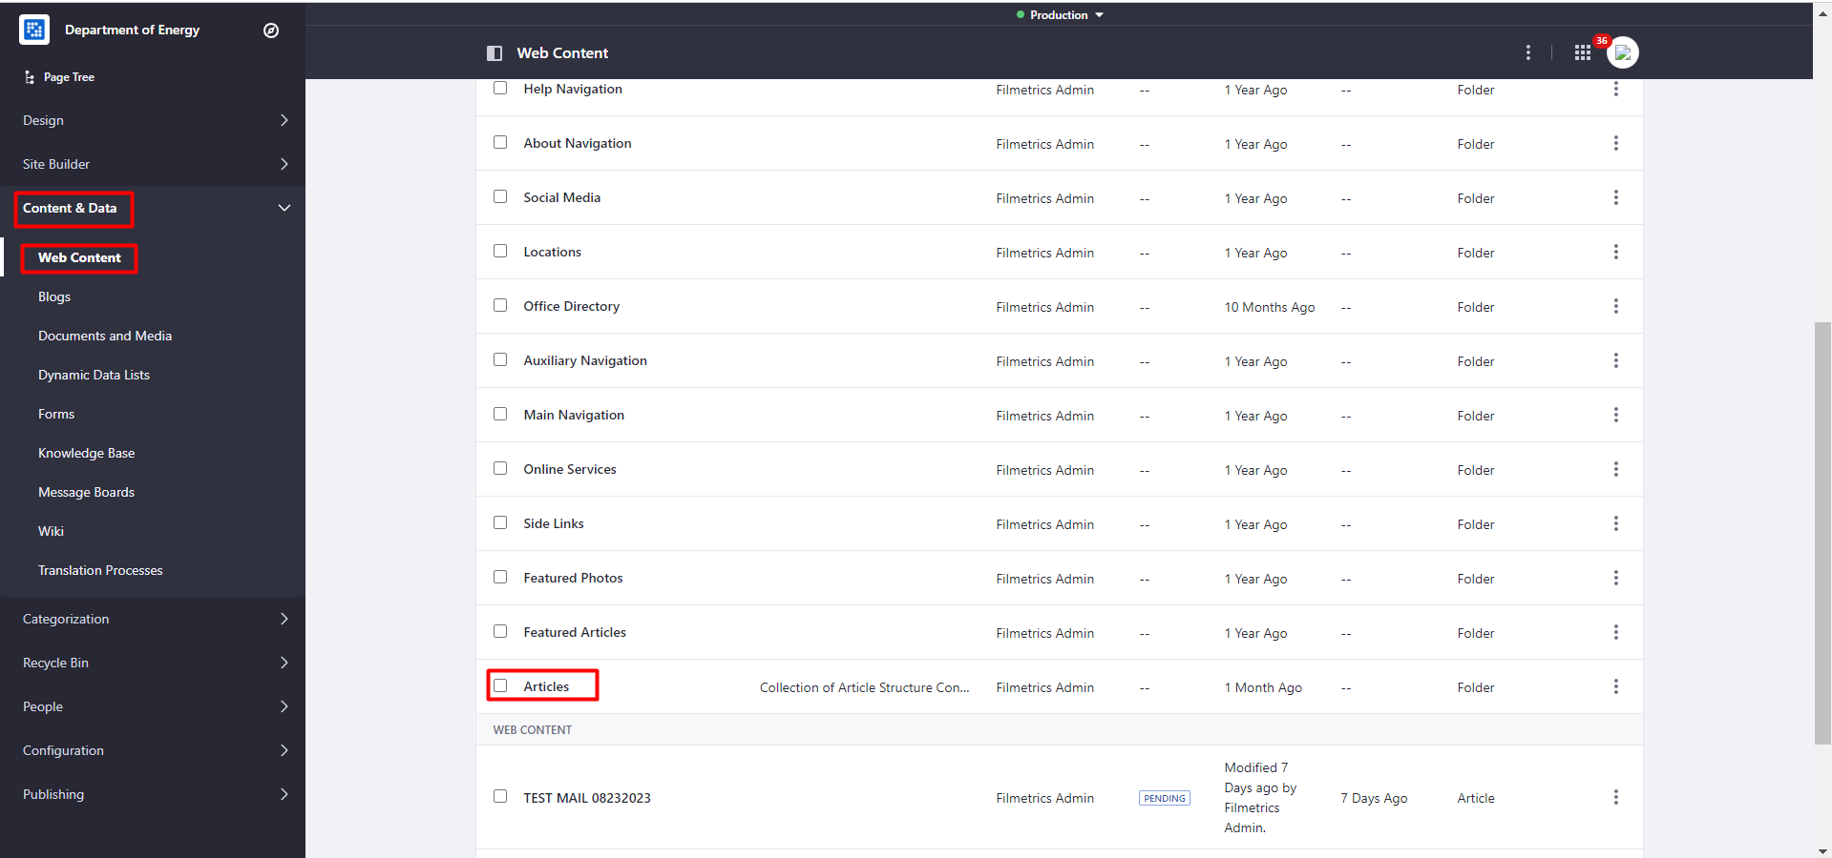
How to Create an Article
1. Go to Content & Data > Web Content and Select Articles Folder.

Slide 41
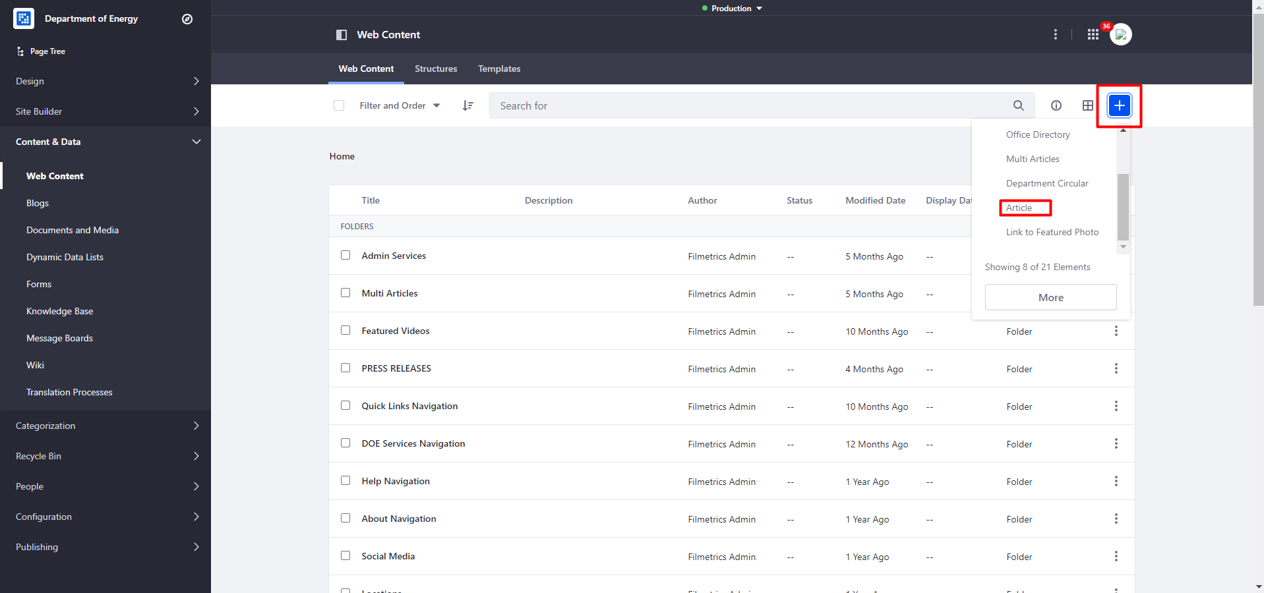
How to Create an Article
2. Click + button and Select Article.

Slide 42
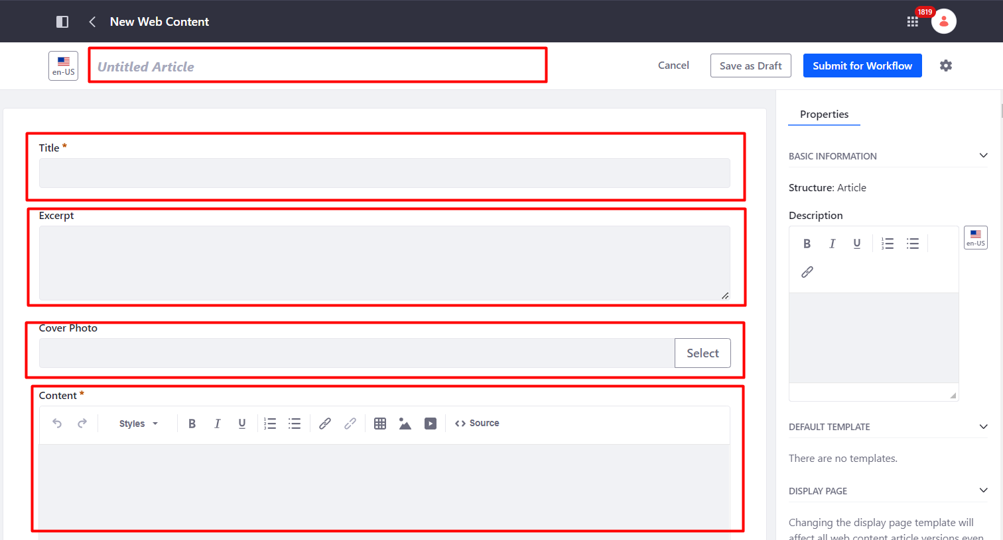
How to Create an Article
3. Provide the ff. fields:
- Content Name
- Article Title
- Excerpt (if applicable)
- Cover Photo (if applicable)
- Content
- Attachment (if applicable)
- Credits (if applicable)

Slide 43
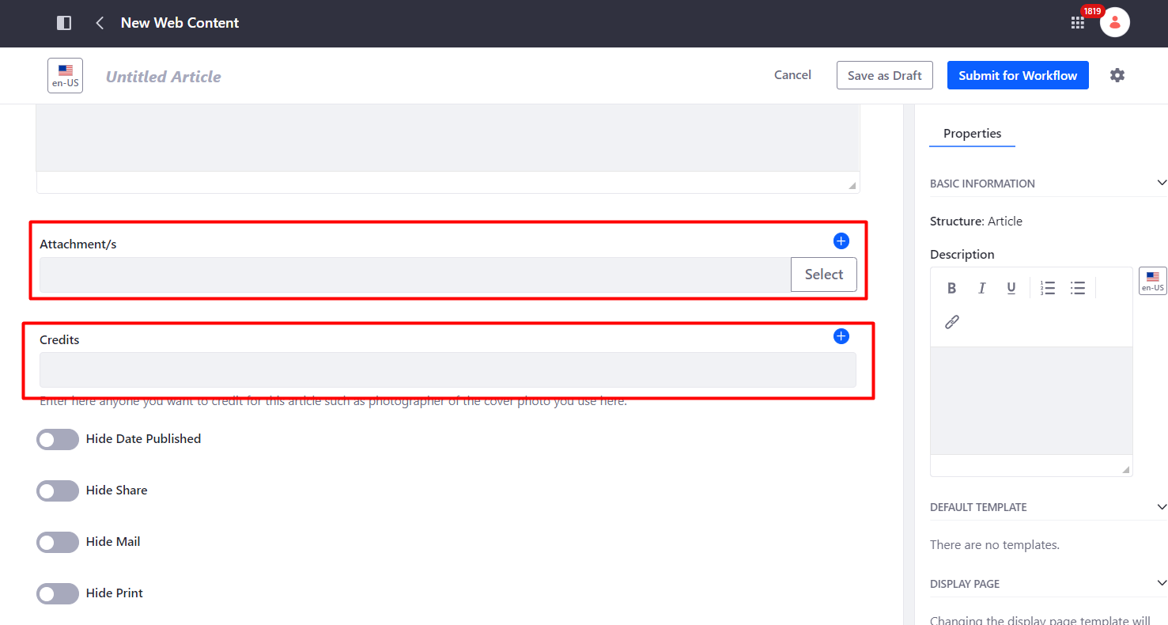
How to Create an Article
3. Provide the ff. fields:
- Content Name
- Article Title
- Excerpt (if applicable)
- Cover Photo (if applicable)
- Content
- Attachment (if applicable)
- Credits (if applicable)

Slide 44
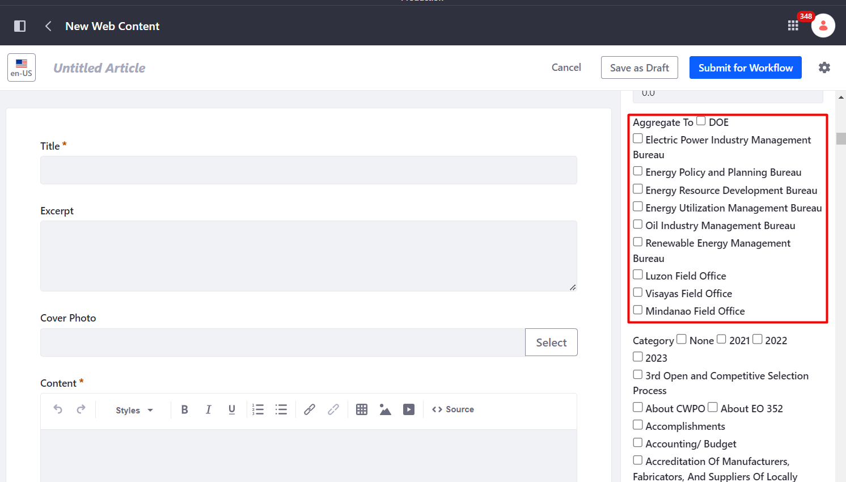
How to Create an Article
4. Select a page or pages to display the article by selecting Aggregate To (Site), Group, Category, Subcategory (if applicable), Type and Subtype (if applicable), and Subject and Subtopic (if applicable).

Slide 45
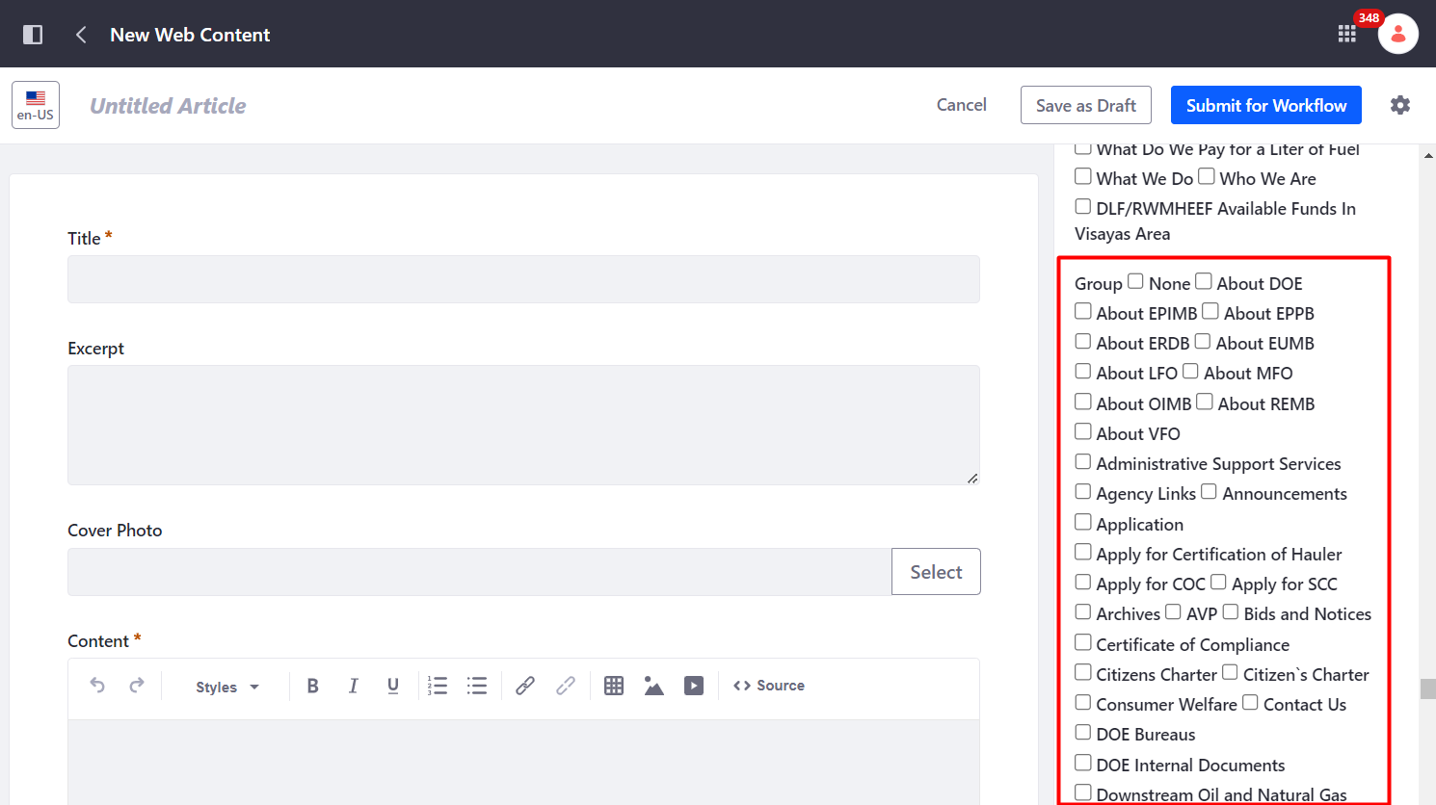
How to Create an Article
4. Select a page or pages to display the article by selecting Aggregate To (Site), Group, Category, Subcategory (if applicable), Type and Subtype (if applicable), and Subject and Subtopic (if applicable).

Slide 46
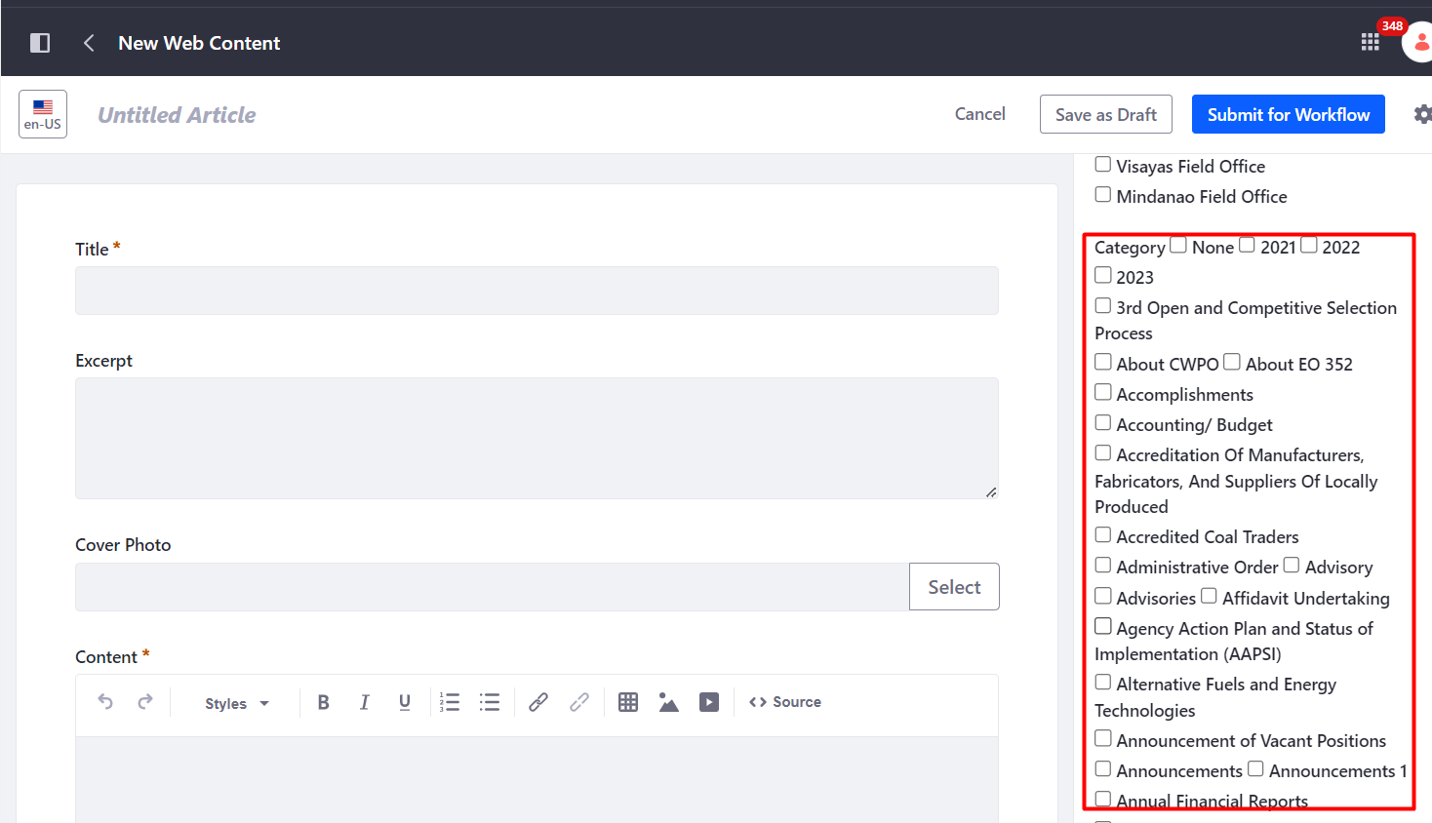
How to Create an Article
4. Select a page or pages to display the article by selecting Aggregate To (Site), Group, Category, Subcategory (if applicable), Type and Subtype (if applicable), and Subject and Subtopic (if applicable).

Slide 47
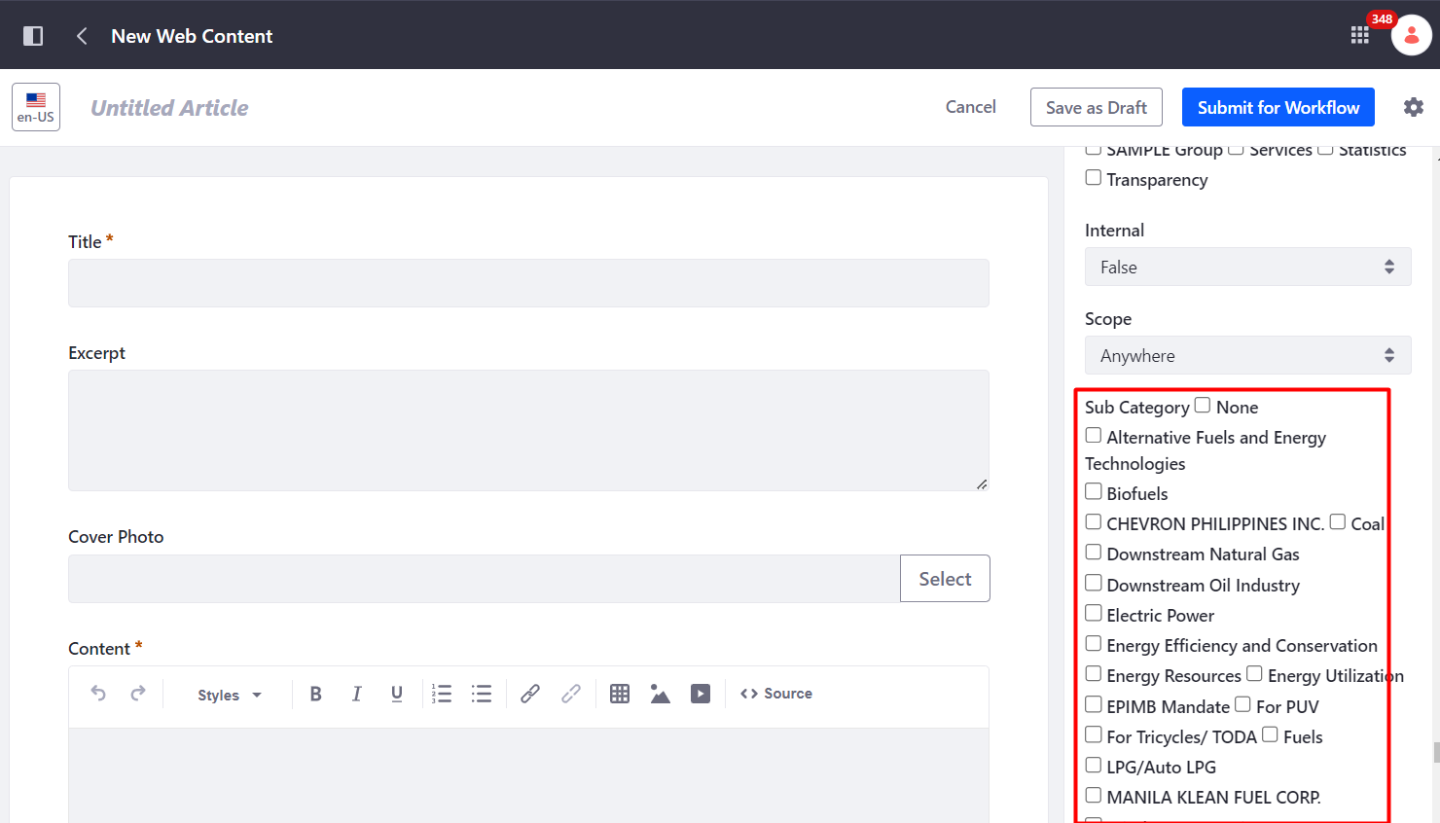
How to Create an Article
4. Select a page or pages to display the article by selecting Aggregate To (Site), Group, Category, Subcategory (if applicable), Type and Subtype (if applicable), and Subject and Subtopic (if applicable).

Slide 48
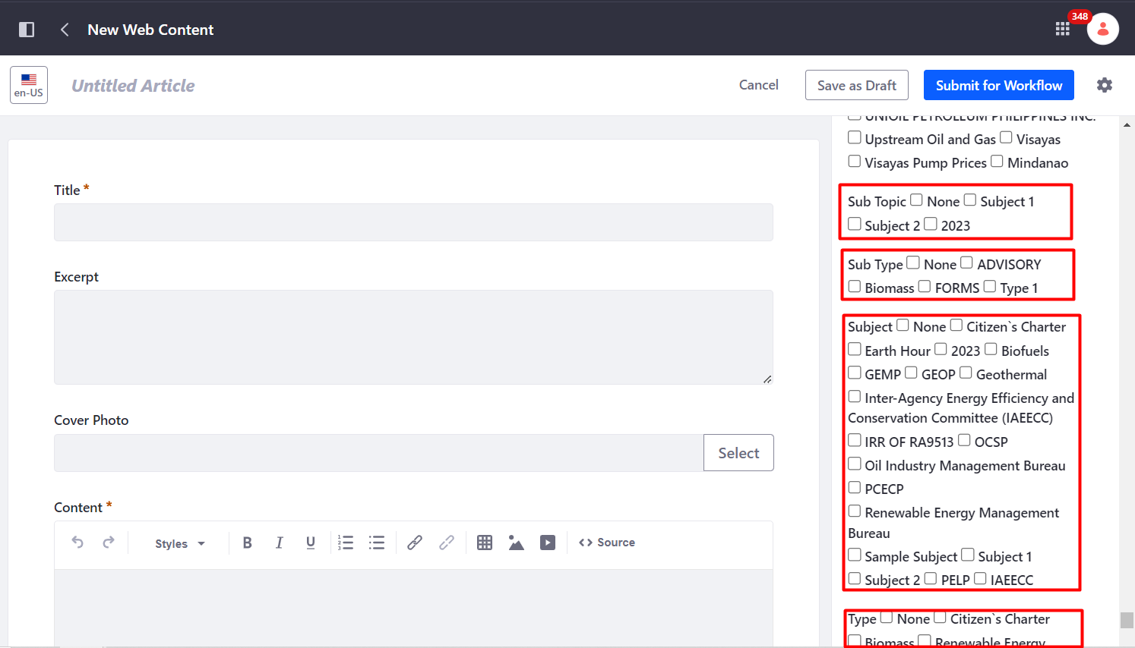
How to Create an Article
4. Select a page or pages to display the article by selecting Aggregate To (Site), Group, Category, Subcategory (if applicable), Type and Subtype (if applicable), and Subject and Subtopic (if applicable).

Slide 49
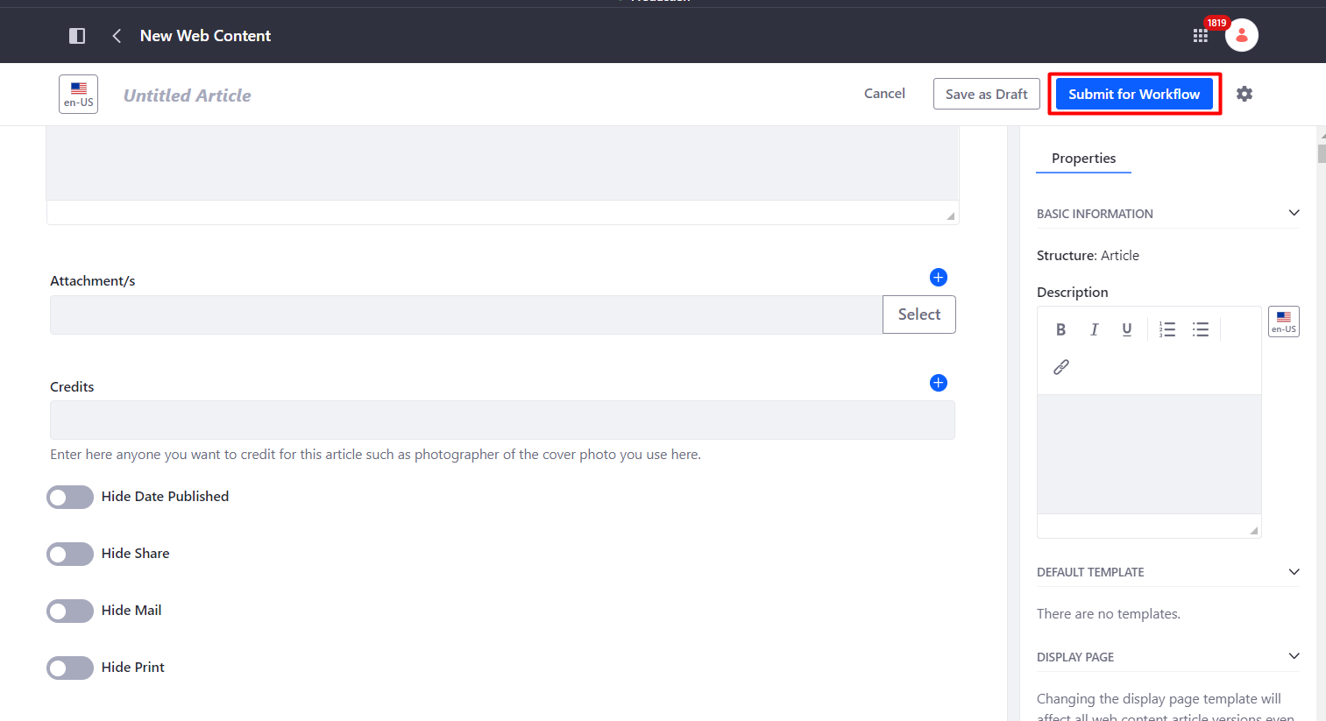
How to Create an Article
5. Click Submit for Workflow.
Notes:
Note: Published Date and Share, Mail and Print icons can be hidden if not applicable in the article. The user needs to click the toggle button/s to hide/unhide.
Portal Content Reviewer or Approver should be the one who will check and finalize the properties/aggregation for the Article to reflect in the Frontend.
Approved articles automatically appear in What’s New.

Slide 50
How to Create a Department Circular Content
1. Go to Content & Data > Web Content and Select Articles Folder.

Slide 51
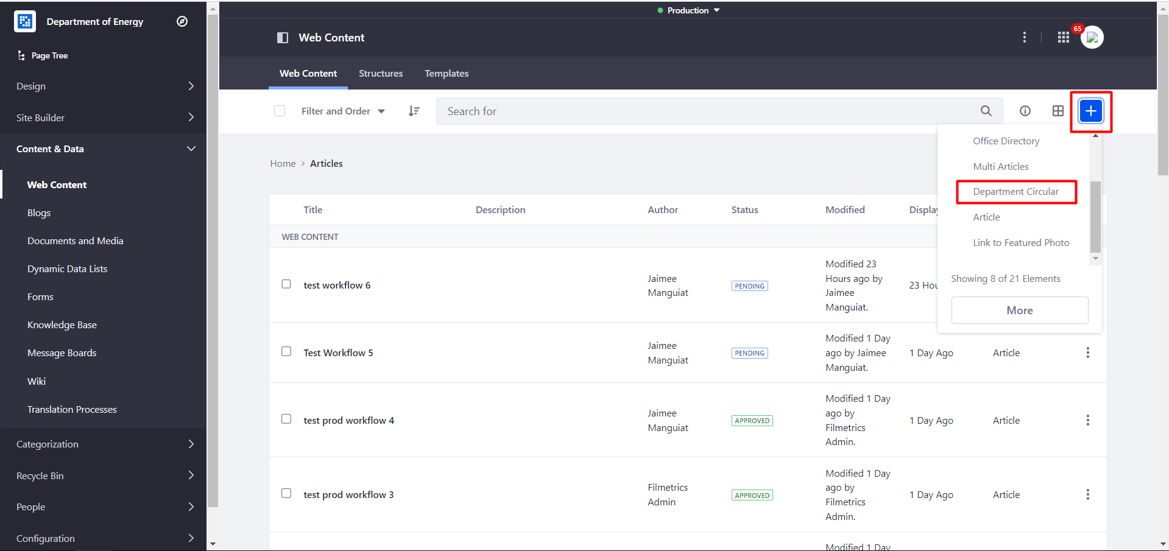
How to Create a Department Circular Content
2. Click + button and Select Department Circular.

Slide 52
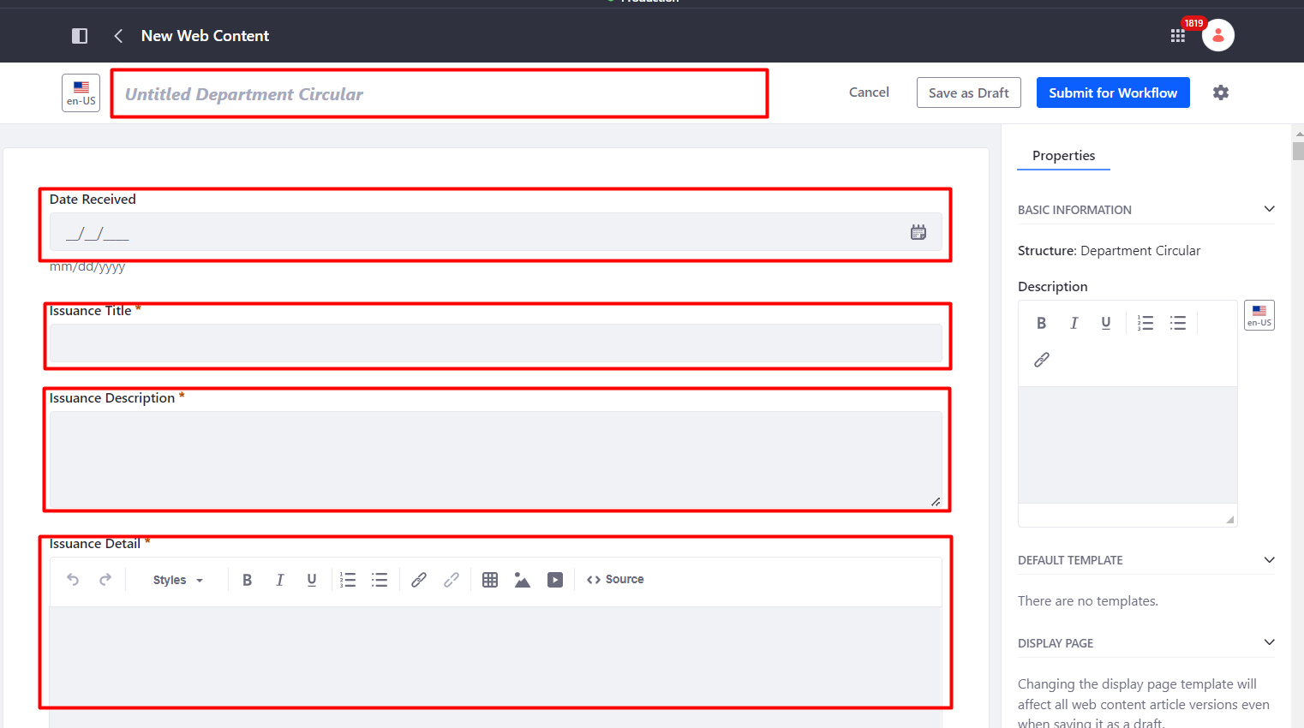
How to Create a Department Circular Content
3. Provide the ff. fields:
- Content Name
- Date Received (if available)
- Issuance Title
- Issuance Description
- Issuance Detail
- Attachment (should select a file in Documents and Media)
- Date Published
- Published at
- Date Submitted to Onar (if available).

Slide 53
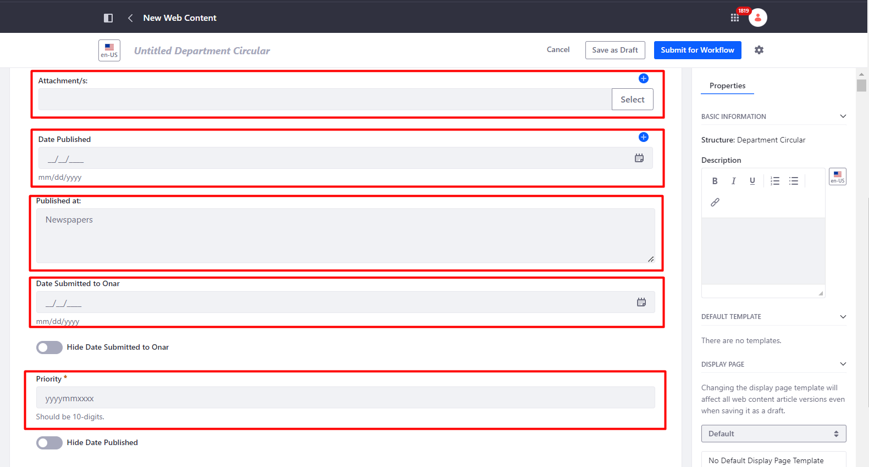
How to Create a Department Circular Content
3. Provide the ff. fields:
- Content Name
- Date Received (if available)
- Issuance Title
- Issuance Description
- Issuance Detail
- Attachment (should select a file in Documents and Media)
- Date Published
- Published at
- Date Submitted to Onar (if available).

Slide 54
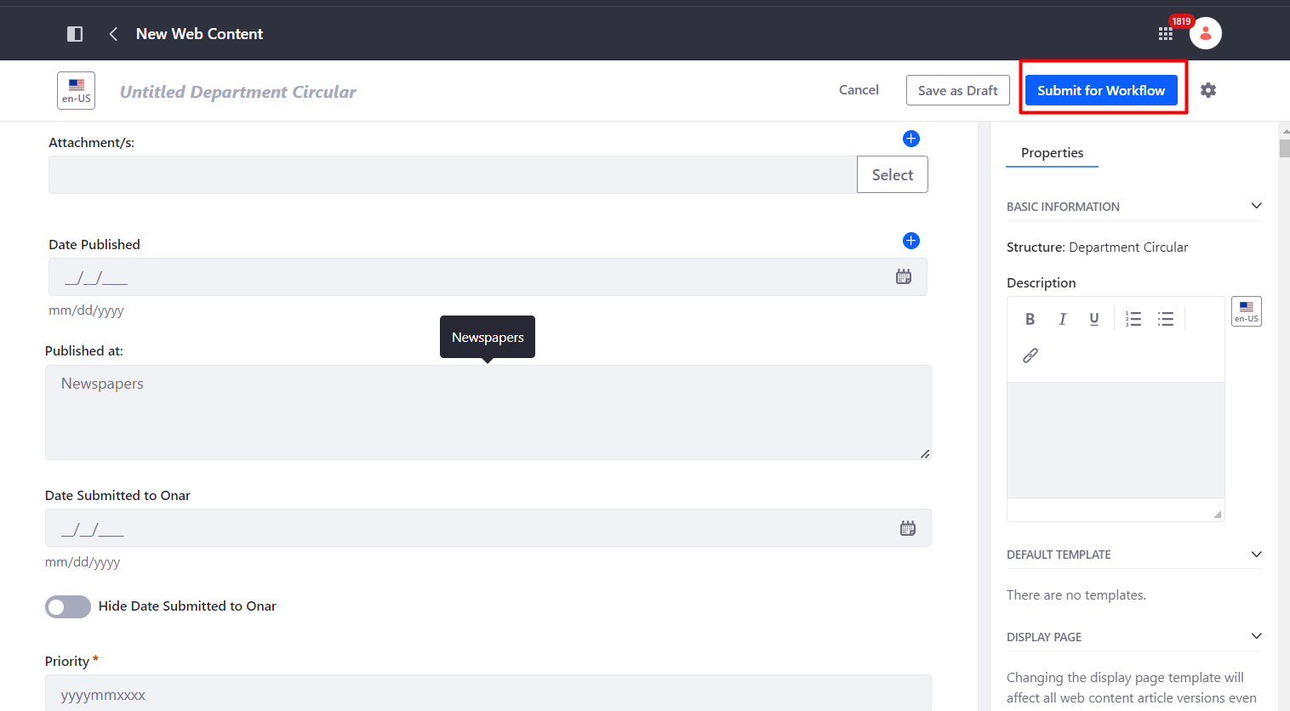
How to Create a Department Circular Content
4. Click Submit for Workflow.
Notes:
Note Portal Content Reviewer or Approver should be the one who will check and finalize the properties/aggregation for the Department Circular to reflect in the Frontend.
Approved Department Circular articles automatically appear in What’s New.

Slide 55
How to Create a Bid Opportunities Content
1. Go to Content & Data > Web Content and Select Articles Folder.

Slide 56
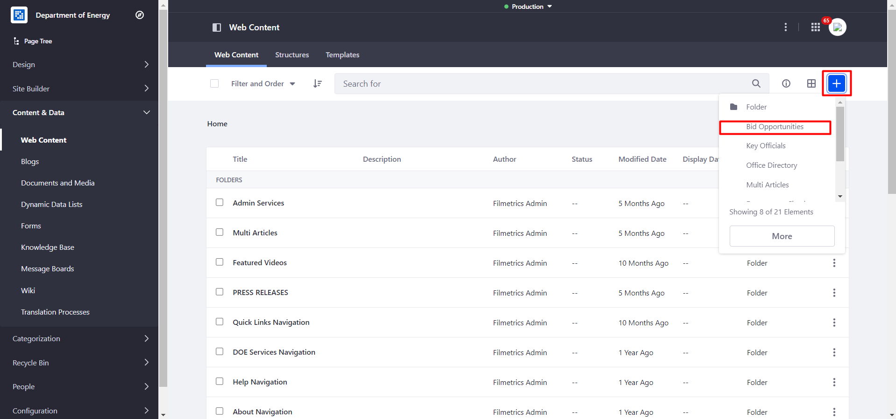
How to Create a Bid Opportunities Content
2. Click + button and Select Bid Opportunities.

Slide 57
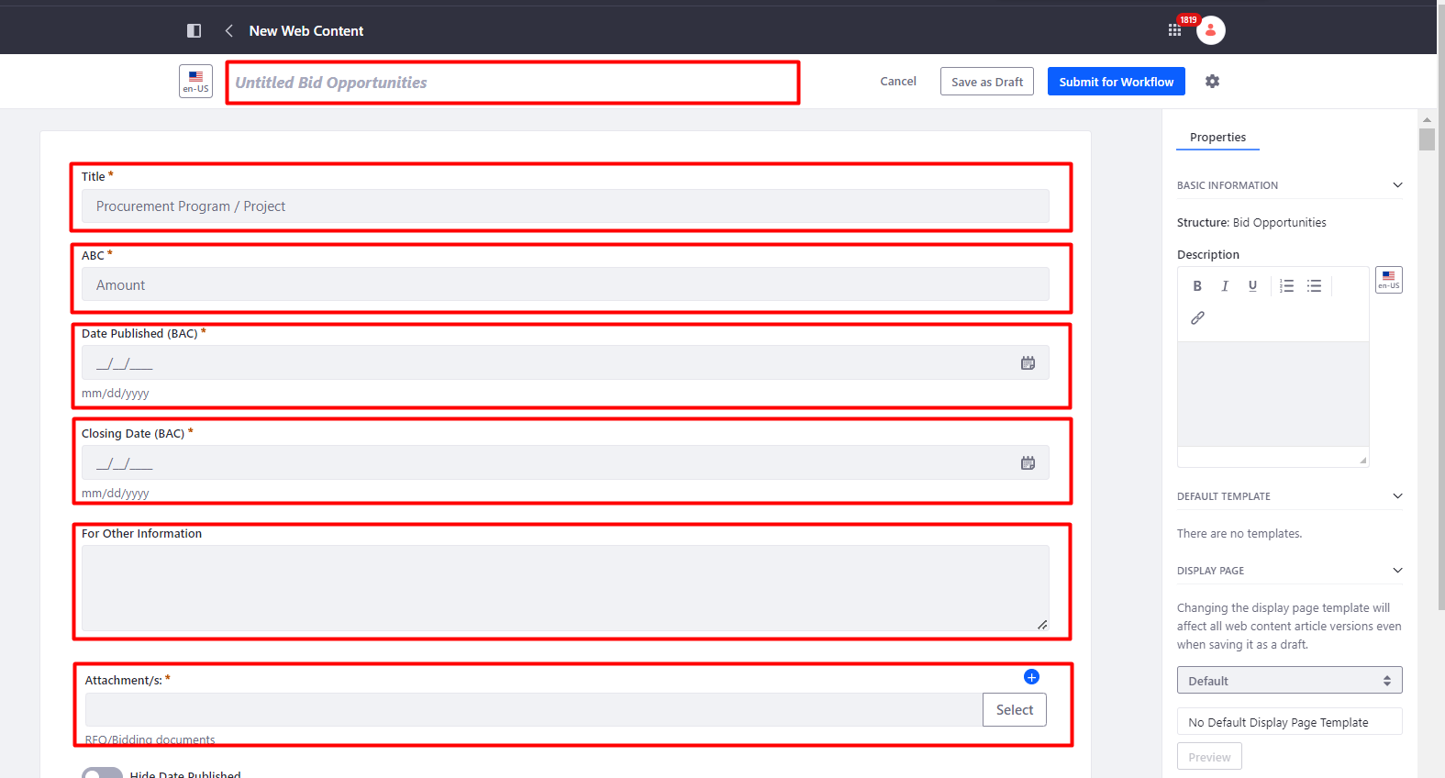
How to Create a Bid Opportunities Content
3. Provide the ff. fields:
- Content Name
- Title (Procurement Program/ Project)
- ABC (Amount)
- Date Published (BAC)
- Closing Date (BAC)
- For Other Information
- Attachment/s (RFQ/Bidding documents)

Slide 58
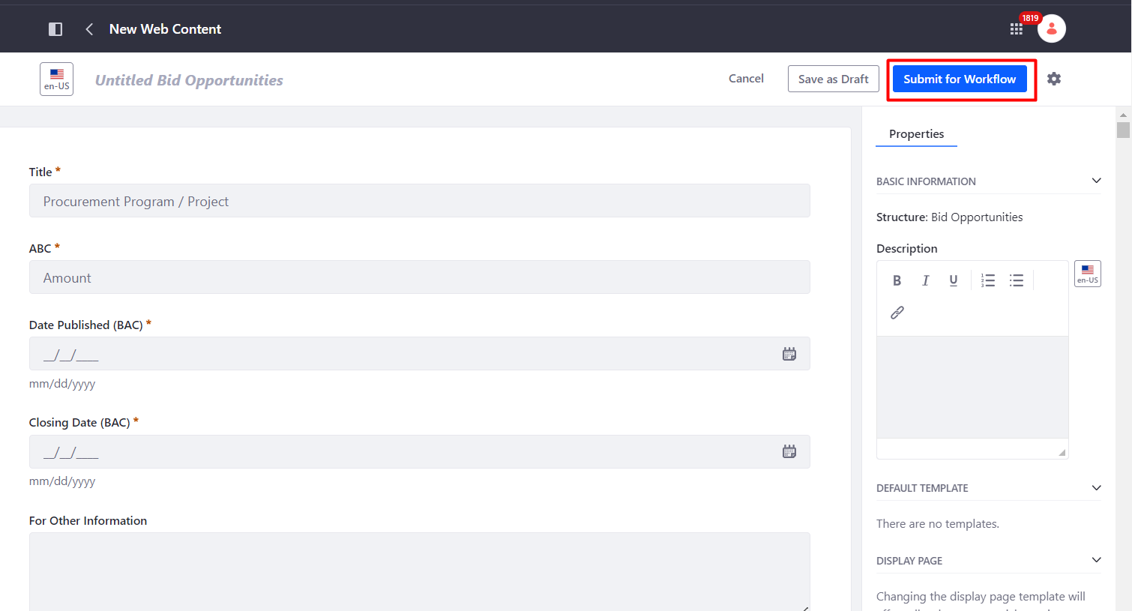
How to Create a Bid Opportunities Content
4. Click Submit for Workflow.
Notes:
Note: Portal Content Reviewer or Approver should be the one who will check and finalize the properties/aggregation for the Bid Opportunities to reflect in the Frontend.
Approved Bid Opportunities automatically appear in What’s New.

Slide 59
How to Create a Key Officials Content
1. Go to Content & Data > Web Content and Select Articles Folder.

Slide 60
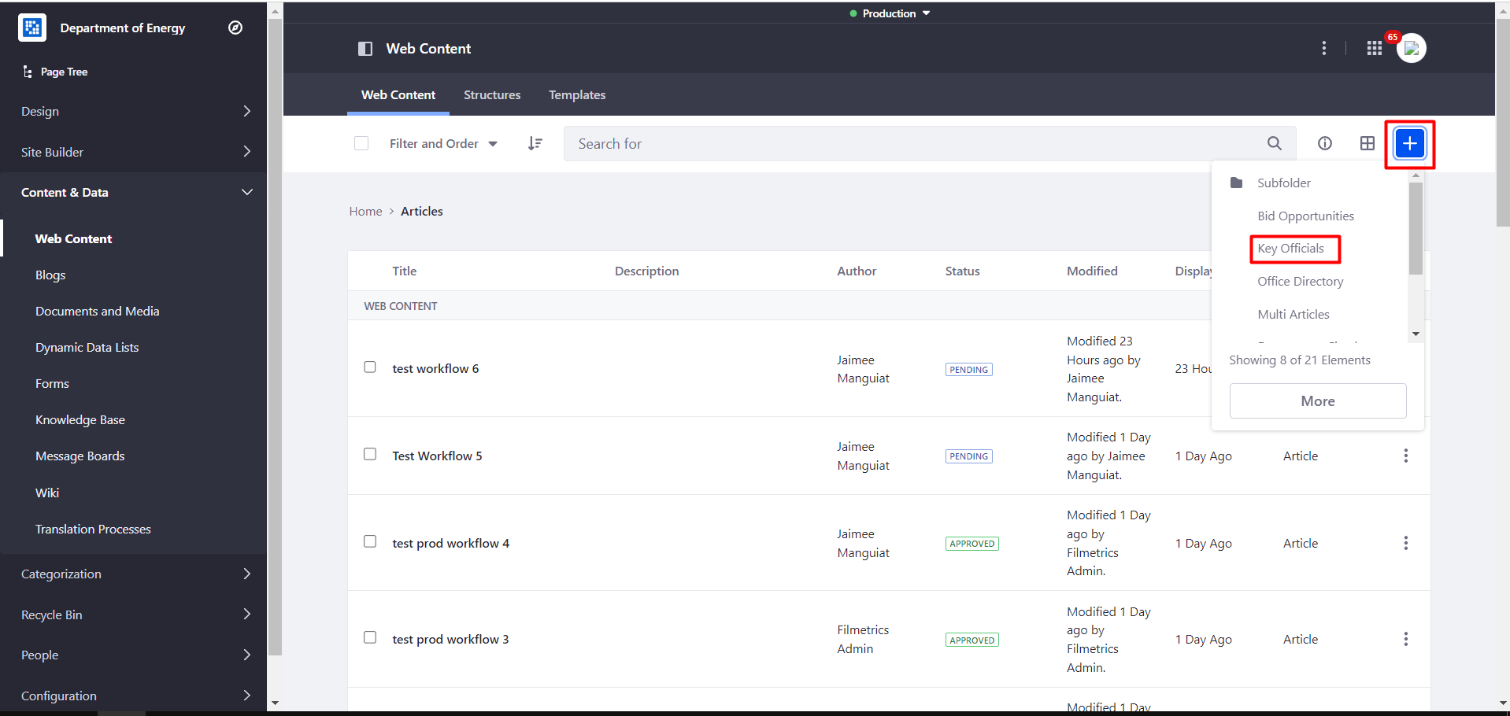
How to Create a Key Officials Content
2. Click + button and Select Key Officials.

Slide 61
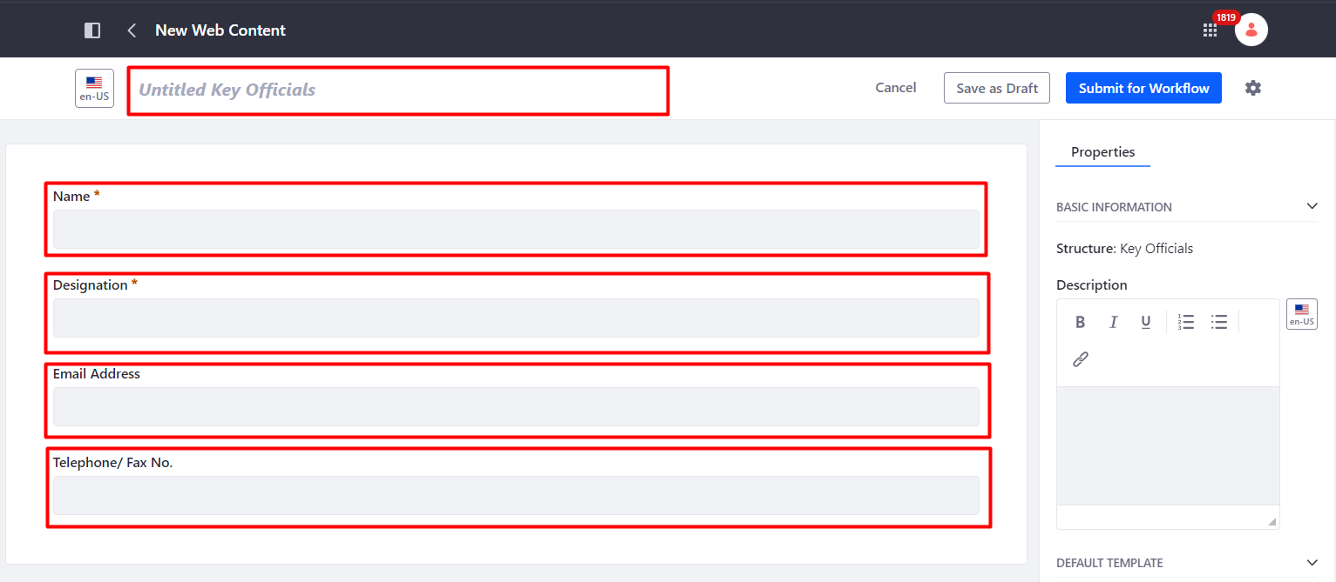
How to Create a Key Officials Content
3. Provide the ff. fields:
- Content Name
- Name
- Designation
- Email Address
- Telephone/ Fax No.

Slide 62
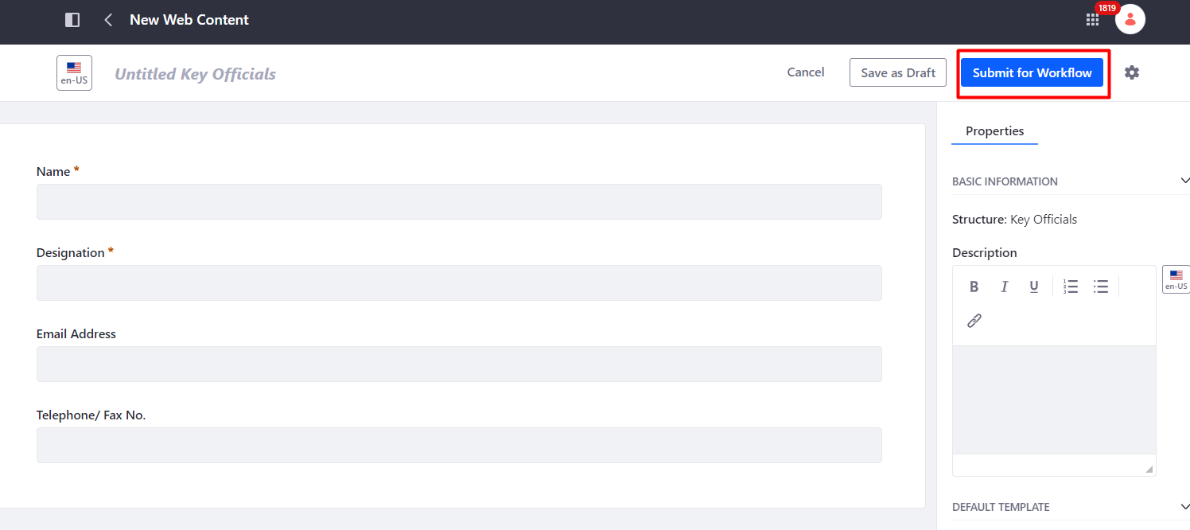
How to Create a Key Officials Content
4. Click Submit for Workflow.
Notes:
Note: Portal Content Reviewer or Approver should be the one who will check and finalize the properties/aggregation for the Bid Opportunities to reflect in the Frontend.
Approved Bid Opportunities automatically appear in What’s New.

Slide 63
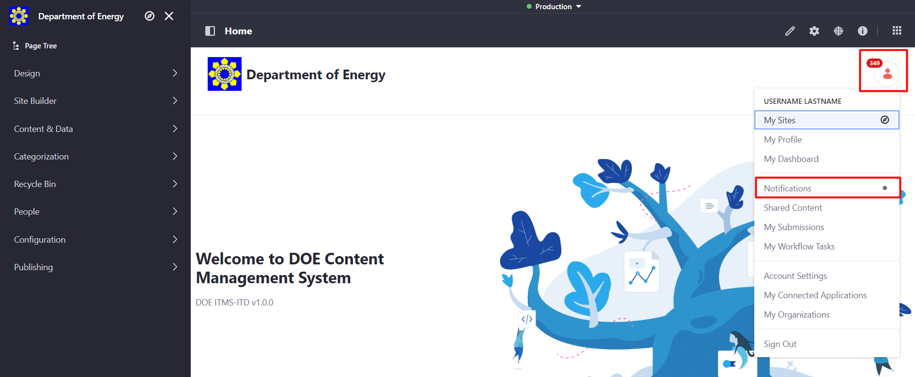
Signing Out
Click User Profile Icon → Sign Out.

Slide 64
Portal Content Reviewer

Slide 65
How to Review a Content
1. Go to User Profile Menu > Notifications.

Slide 66
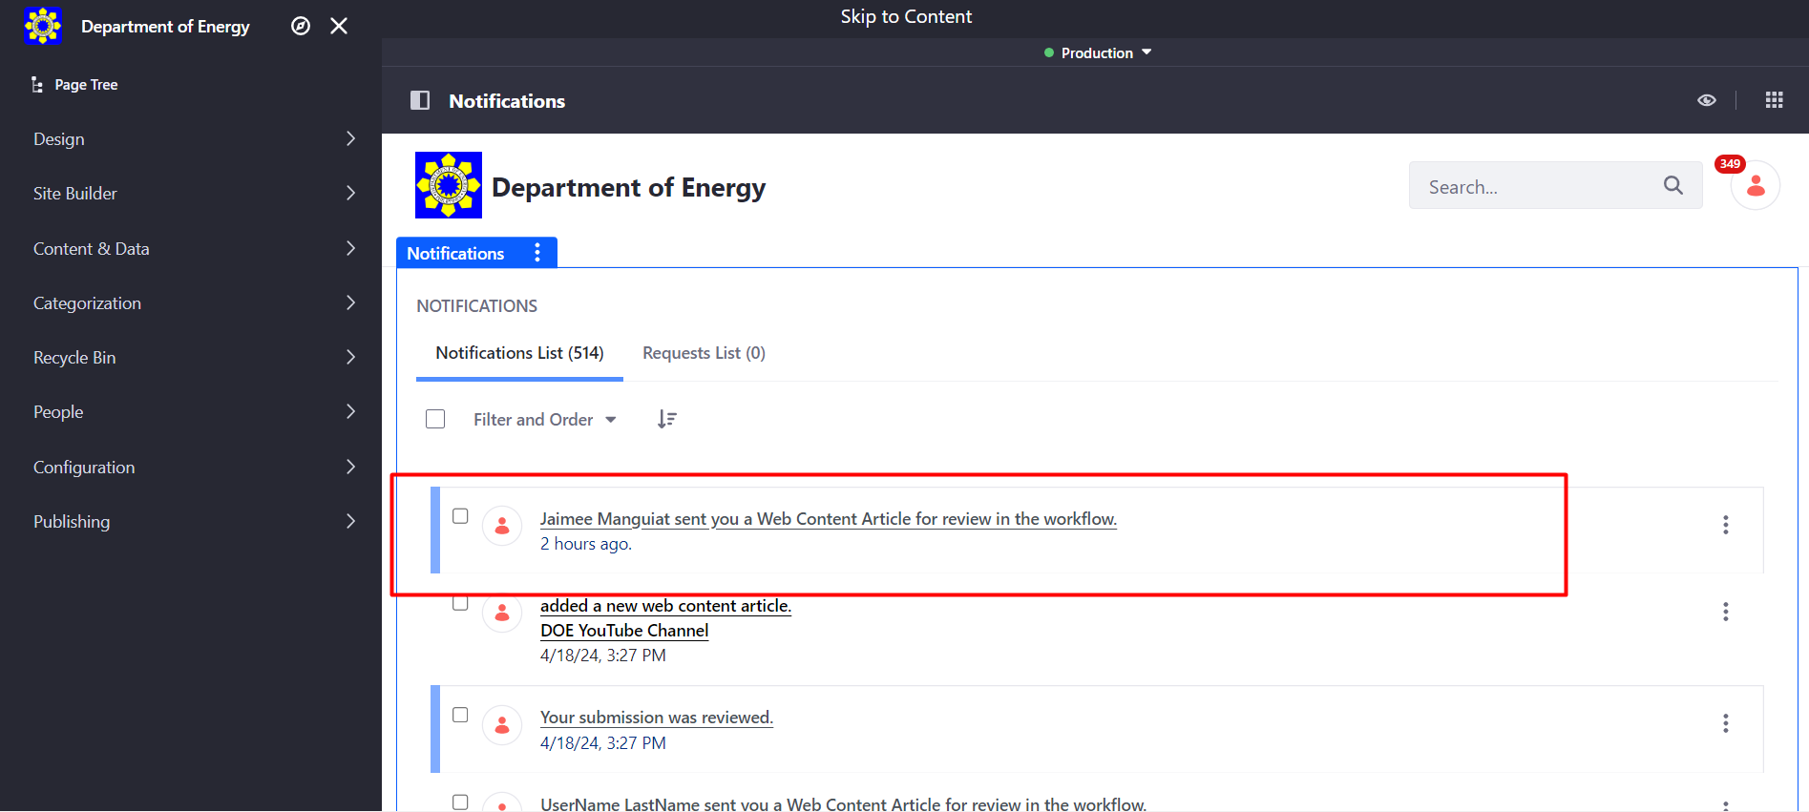
How to Review a Content
2. Select an article to review from the Notifications List.

Slide 67
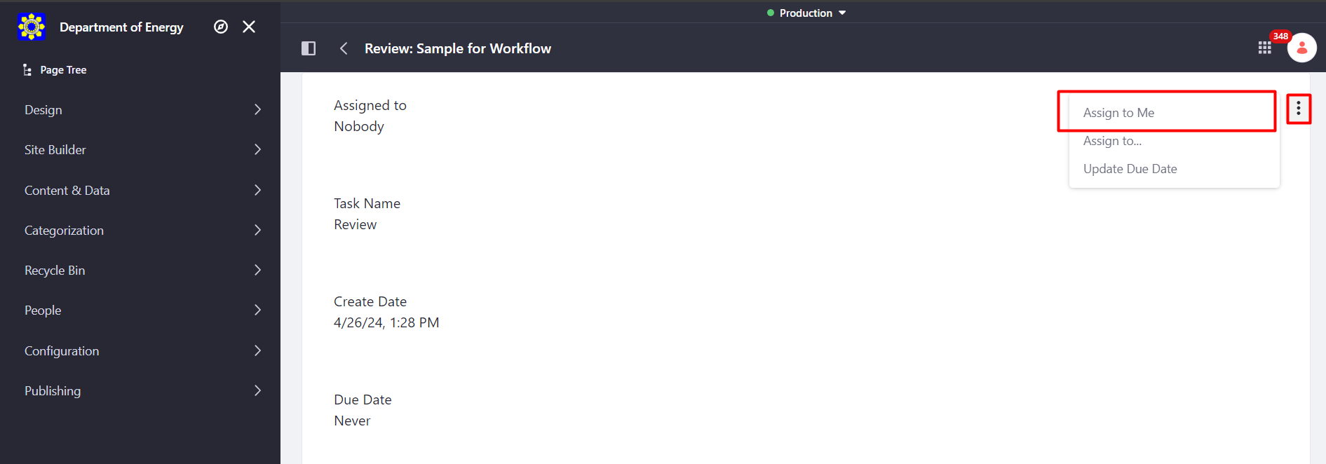
How to Review a Content
3. Click the three-dot icon and select Assign to Me. Then click Done.

Slide 68
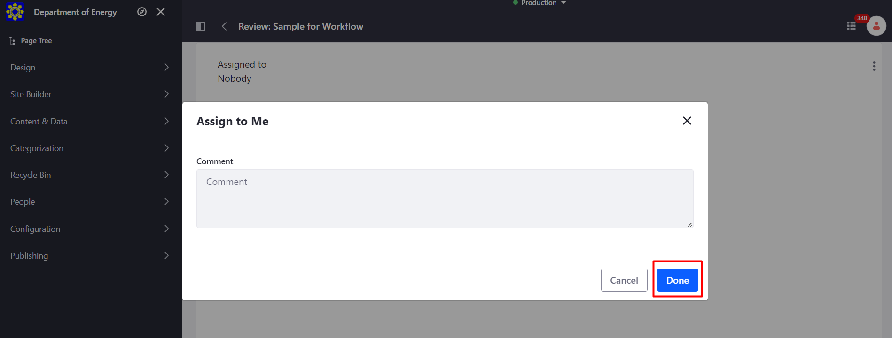
How to Review a Content
3. Click the three-dot icon and select Assign to Me. Then click Done.

Slide 69
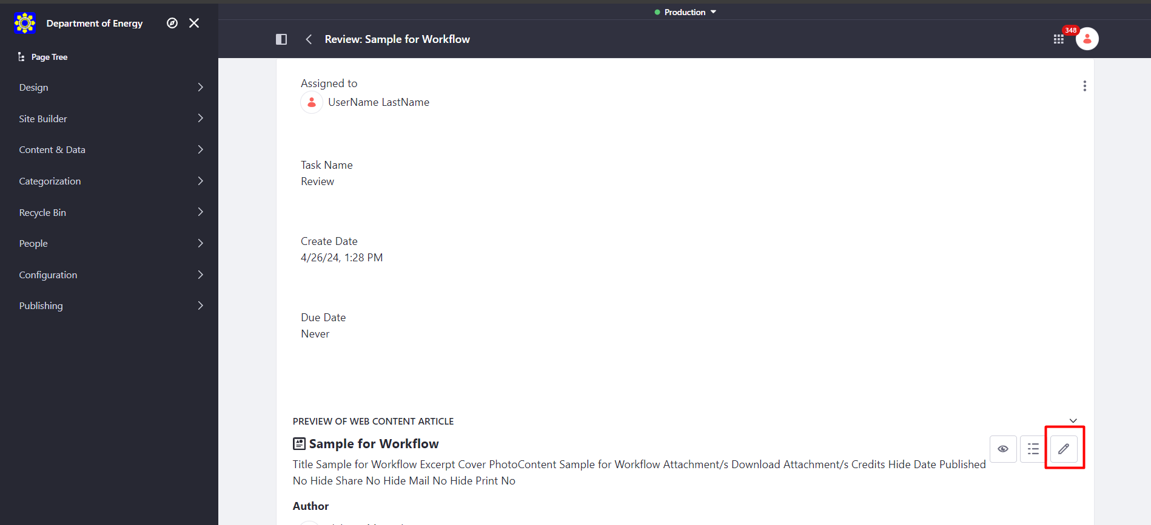
How to Review a Content
4. Check, review or edit the article by clicking the edit button.

Slide 70
How to Review a Content
5. After editing the content of the article, select a page or pages to display the article Aggregate To (Site), Group, Category, Subcategory (if applicable), Type and Subtype (if applicable), and Subject and Subtopic (if applicable).

Slide 71
How to Review a Content
5. After editing the content of the article, select a page or pages to display the article Aggregate To (Site), Group, Category, Subcategory (if applicable), Type and Subtype (if applicable), and Subject and Subtopic (if applicable).

Slide 72
How to Review a Content
5. After editing the content of the article, select a page or pages to display the article Aggregate To (Site), Group, Category, Subcategory (if applicable), Type and Subtype (if applicable), and Subject and Subtopic (if applicable).

Slide 73
How to Review a Content
5. After editing the content of the article, select a page or pages to display the article Aggregate To (Site), Group, Category, Subcategory (if applicable), Type and Subtype (if applicable), and Subject and Subtopic (if applicable).

Slide 74
How to Review a Content
5. After editing the content of the article, select a page or pages to display the article Aggregate To (Site), Group, Category, Subcategory (if applicable), Type and Subtype (if applicable), and Subject and Subtopic (if applicable).

Slide 75
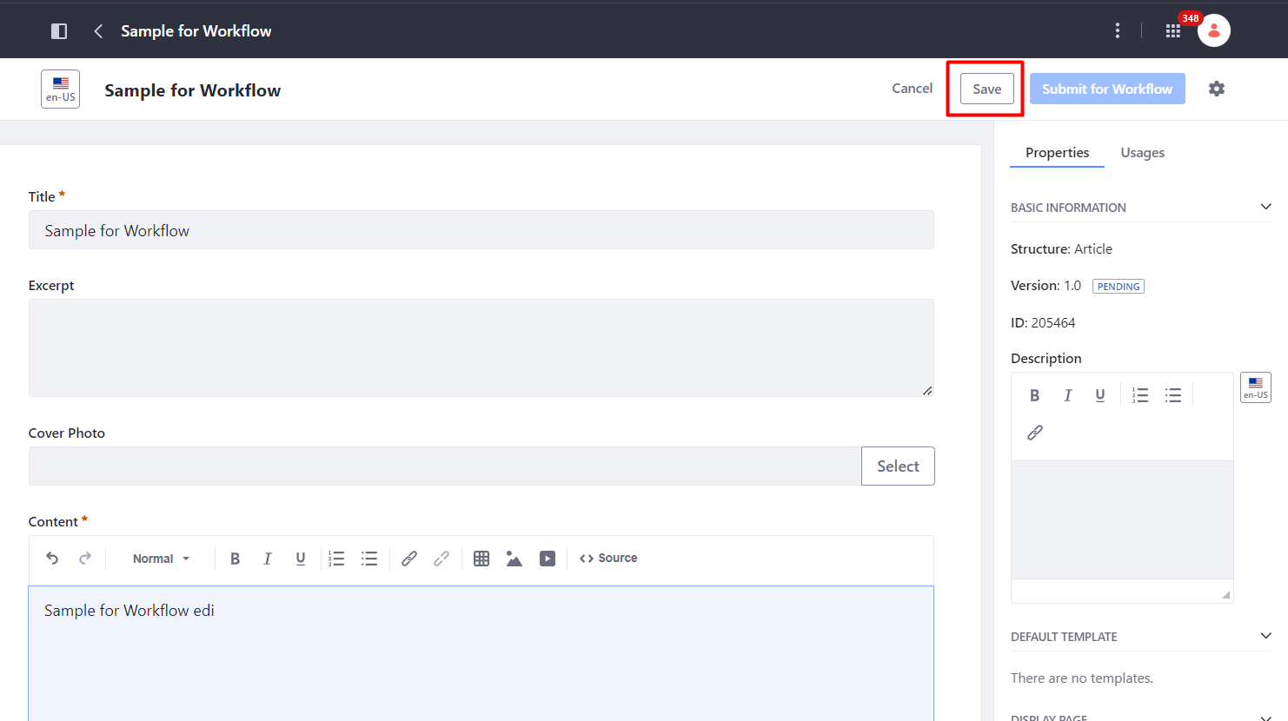
How to Review a Content
6. After updating the properties, click the Save button. Go back to the notification list and click the article you are reviewing.

Slide 76
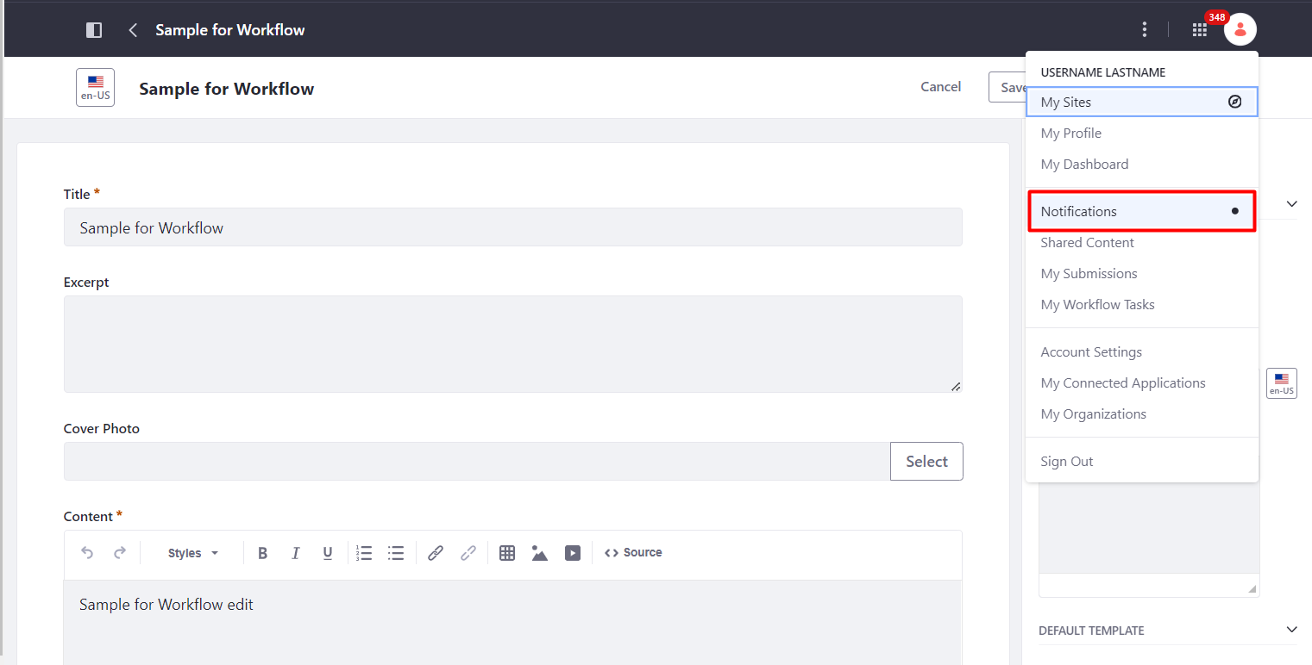
How to Review a Content
6. After updating the properties, click the Save button. Go back to the notification list and click the article you are reviewing.

Slide 77
How to Review a Content
6. After updating the properties, click the Save button. Go back to the notification list and click the article you are reviewing.

Slide 78
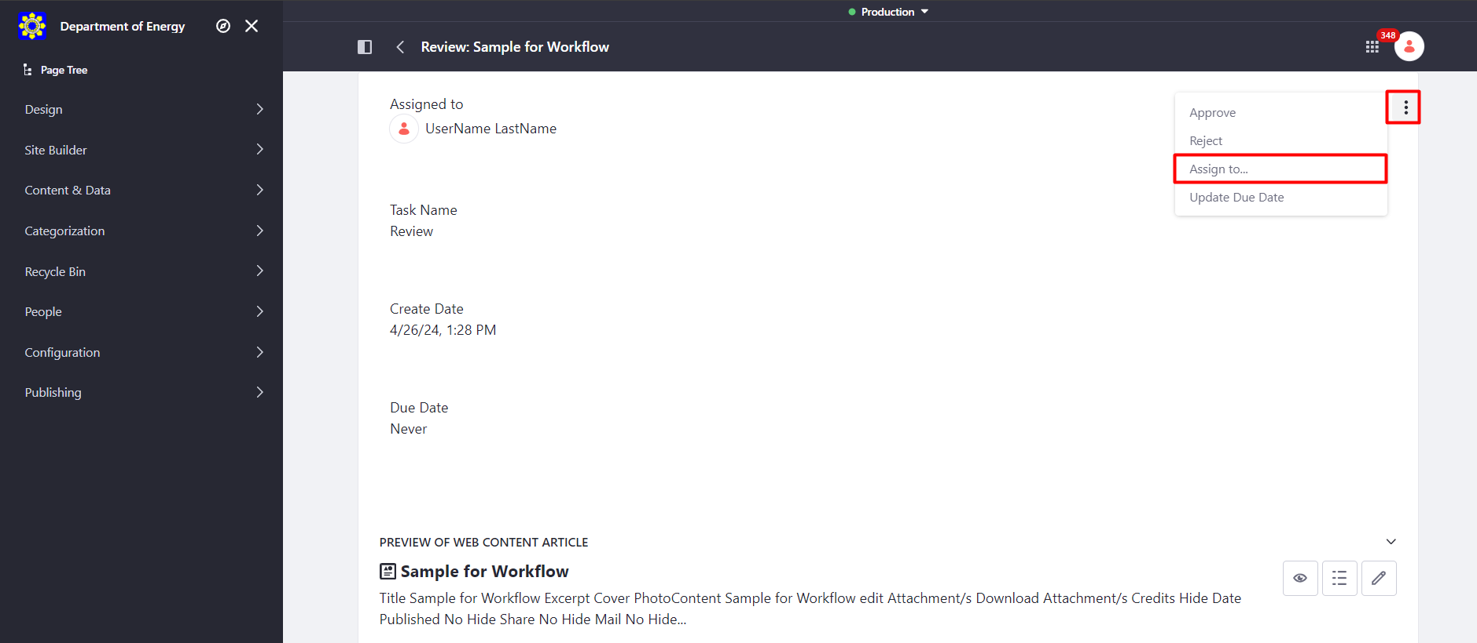
How to Review a Content
7. Click the three-dot icon, select Assign to, choose approver for approval and click Done.

Slide 79
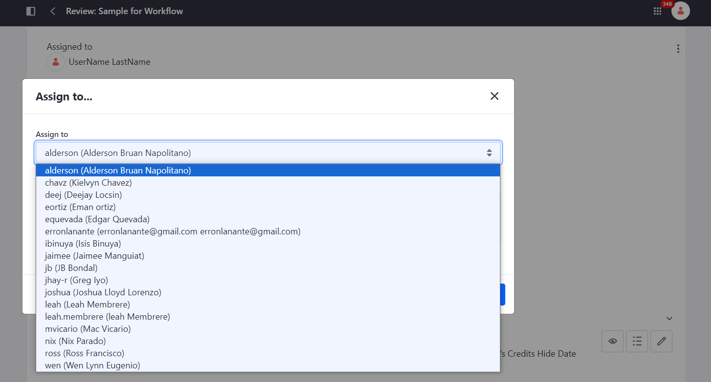
How to Review a Content
7. Click the three-dot icon, select Assign to, choose approver for approval and click Done.

Slide 80
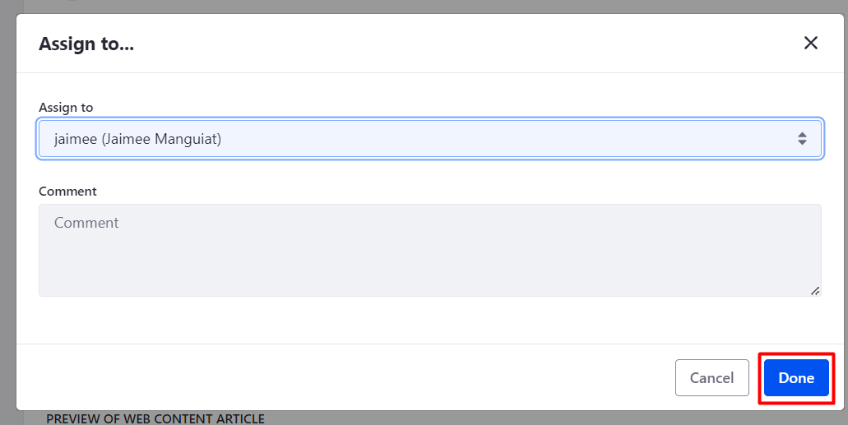
How to Review a Content
7. Click the three-dot icon, select Assign to, choose approver for approval and click Done.

Slide 81
Portal Content Approver

Slide 82
How to Approve a Content
1. Go to User Profile Menu > Notifications.

Slide 83
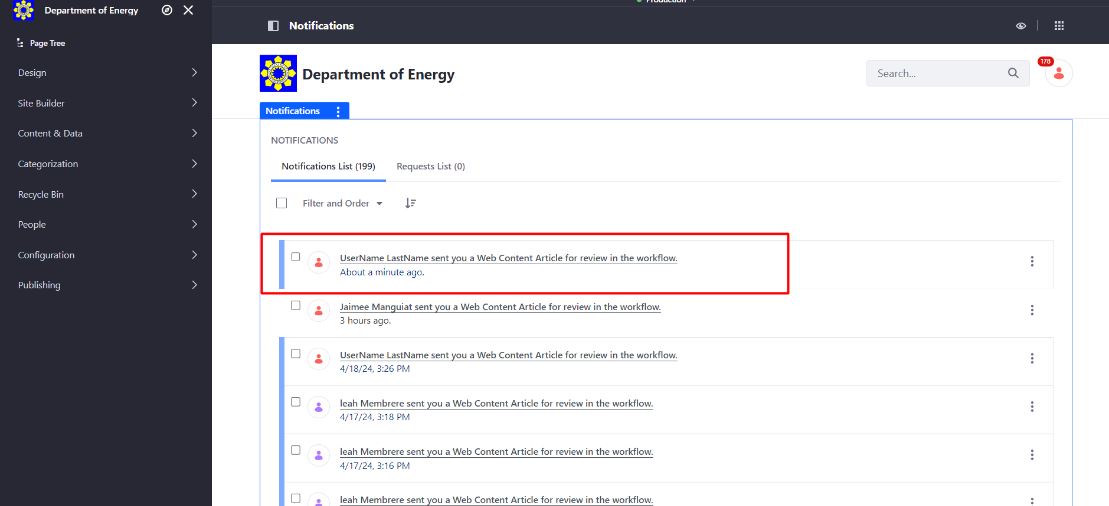
How to Approve a Content
2. Select an article to review from the Notifications List.

Slide 84
How to Approve a Content
3. Check, review or edit the article by clicking the edit button.

Slide 85
How to Approve a Content
4. After editing the article and checking the selected aggregations in the properties, click the Save button. Go back to the notification list and click the article you are reviewing.

Slide 86
How to Approve a Content
4. After editing the article and checking the selected aggregations in the properties, click the Save button. Go back to the notification list and click the article you are reviewing.

Slide 87
How to Approve a Content
4. After editing the article and checking the selected aggregations in the properties, click the Save button. Go back to the notification list and click the article you are reviewing.

Slide 88
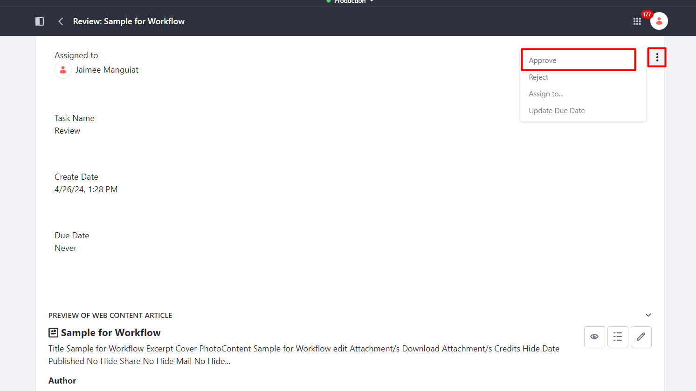
How to Approve a Content
5. Click the three-dot icon, select Approve and click Done.

Slide 89
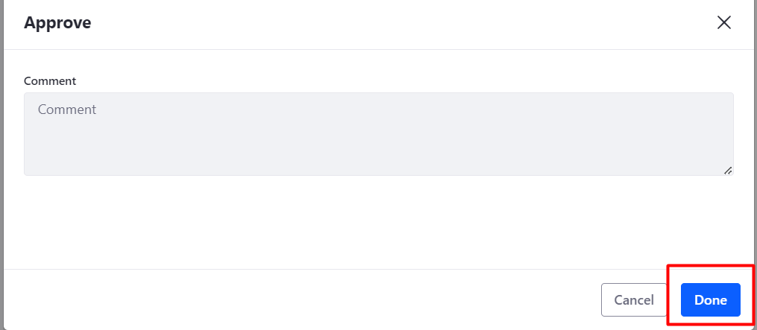
How to Approve a Content
5. Click the three-dot icon, select Approve and click Done.

Slide 90
QUESTIONS?

Slide 91
End of Presentation
Department of Energy

