Slide 1


Department of Energy
ESTABLISHMENT OF ENERGY PORTAL
Welcome to
Content Management System Training
October 20-21, 2022
Notes:
This training is designed to enable our DOE content contributors and administrators to effectively manage your contents for the Energy Portal and its child portals.

Slide 2

Agenda
Getting Started with Liferay Content Management System (CMS) platform
Discuss the different features of the Liferay (DOE CMS) Platform
Introduction to Admin Account
Create our first child site
Map and Publish our content to Portal
Navigate the system!
System Link: https://doe-filmetrics.com/
Notes:
Our aim is to equip you with the right knowledge, skills, and frame of mind needed for Energy Portal management.
Getting Started with Liferay Content Management System (CMS) platform
Discuss the different features of the Liferay (DOE CMS) Platform
Introduction to Admin Account
Create our first child site
DAY 2
Map and Publish our content to Portal
Navigate the system!
System Link: https://doe-filmetrics.com/

Slide 3
House Rules
ACTIVELY PARTICIPATE
BE RESPECTFUL
DO NOT FORGET TO MUTE WHEN NOT ANSWERING OR ASKING QUESTIONS
RAISE YOUR VIRTUAL HAND OR USE CHAT BOX IF YOU HAVE QUESTIONS
Notes:
In addition to having our training agenda that guides us as participants towards accomplishing our training goals, we need to have first a clear understanding of what is expected of us to best support our activity.
Actively Participate - It will be a pleasure to hear you all answering/asking questions.
Be Respectful - This session is our training ground. It's okay to make mistakes or have many questions in mind during our training. What matters is that we learn.
DON'T FORGET TO MUTE WHEN NOT ANSWERING/ASKING QUESTIONS - We would like to hear your voice instead of the rooster crowing. Likewise, do not forget to unmute when you participate.
RAISE YOUR VIRTUAL HAND or USE THE CHAT BOX IF YOU HAVE QUESTIONS. - Feel free to ask questions. They are welcome here.You may use the virtual raise hand and/or the chat box.

Slide 4
Objectives
At the end of this session, you are expected to:
DAY 1
Know how to navigate Liferay
Know how to administer your CMS site
DAY 2
Know how to display your content to your portal
Know how to access Knowledge Base

Slide 5
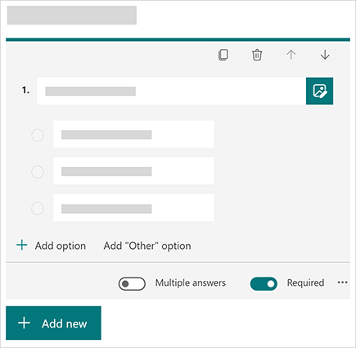
Training Evaluation
Self-Assessment Form
Training Experience Survey Form
Notes:
For us to evaluate if we meet our objectives, we will be providing you with a copy of the Self-Assessment Form. The results of that assessment will not be shared with all the participants in this call but rather we will use it for assessing if we are already ready for the BAU or operations transition.
Aside from that (this one is optional), we will be collecting your feedback about how effective our training is.

Slide 6

GETTING STARTED

Slide 7
What is Content Management System?
A Content Management System (CMS) is a software application that enables users to create, edit, collaborate on, publish and store portal content. In essence, every file that is created and stored as part of a website in the form of pages, images, logos or text contents are categorized. Content Management is a system that gives rights to others or a particular section within an organization to manage the portal.
Notes:
So let us start with the definition of CMS. A content management system (CMS) is a software application that enables users to create, edit, collaborate on, publish and store portal content. In essence, every file that is created and stored as part of a website in the form of pages, images, logos or text contents are categorized as. Content Management is a system that gives rights to others or a particular section within an organization to manage the website.
Rather than developing and building a system that can help in the creation of web pages or store images, CMS can be useful for handling all types of infrastructure work, while you or our ITMS team can concentrate on the consumer-facing areas of the Energy Portal.
In short, our Energy Portal is a website that is developed by using a content management system.

Slide 8
What is a CMS Portal?
Your own requirements and terms
No coding knowledge is required
Simplifies the redesigning of the portal contents
Multiple Access and Collaboration
Portal Security
Cost and Time-saving maintenance
Notes:
What is the use of CMS?
There a number of advantages of CMS, let us look at a few of them:
Updating your Energy Portal as per your own requirements and terms
So let us say your portal is managed or developed by a third-party developer or managed by your IT group, you will need to contact them for each and every small or big change you need to make to your website.
For example, if you want to add images or update about a new event, you will have to ask them to do it for you. Instead of going to the developer for each and every small thing, a CMS website helps you to get rid of this to and from the business.
Your portal can be updated and managed easily by you, without having to depend on a third person. A CMS enables you in making your portal updated, more dynamic and more interesting and useful to your visitors.
No Coding knowledge required
Content management systems are a boon to users who do not have any coding knowledge. They were specifically built keeping in mind users having little to no previous programming experience.
Once your portal is completely developed, you can manage the content on the website easily with a CMS.
The CMS comes with a WYSIWYG editor (What You See Is What You Get), which helps you to manage and edit web content, like images and text on the portal.
It is as simple as creating a document on Microsoft Word. CMS is very useful in creating web pages, blog posts, news articles etc. on the website.
3. Simplifies the redesigning of the web contents
Portals/Websites developed with support from content management system have their designs created separately from the content.
Therefore, in case you want to redesign the portal or make some design-specific changes, you can do so without having rehauled the complete portal. The old design can be easily replaced with a new design in a CMS website. Or you can also create a new portal if there would be any future requirement.
4. Multiple Access and Collaboration
A CMS allows a number of people to have easy access to the portal and also collaborate on different projects while working on it.
Individuals can create their own accounts and by logging through these individual accounts, multiple users can manage, edit or update content on the portal from their own computers or devices.
The CMS helps in storing all the online content and making it available to everyone who has access to the portal. This means you no longer will need to send files multiple times to different individuals.
Content management systems are extremely convenient for people who are always on-the-go, people who would need to access the back-end of the website from different locations.
5. Portal Security
Today it is very important that your website is secure and cannot be hacked. Especially in this fast-growing online world, it is important for website owners to ensure that their portal is safe and secure.
Liferay CMS are regularly tested by computer scientists to ensure that the websites are completely secure. There are a number of plugins and tools also which are available which can be used to increase the website’s security.
6. Time-saving Maintenance
Maintaining a static website is expensive. You need a web developer to frequently update and make changes to maintain it.
Other than the cost involved, it also takes some time for the updates to be seen on the website. Choosing a content management system can help you save both time and money.
Thanks to a CMS you may not have to be dependent on a developer to make some common changes or for maintaining it. CMS is so easy to work, one can easily make these changes when the need arises.
Conclusion
As we discussed there are many advantages of CMS, and they are very useful. Different CMS have different features, and you can select the best CMS for your website depending on your requirement.

Slide 9
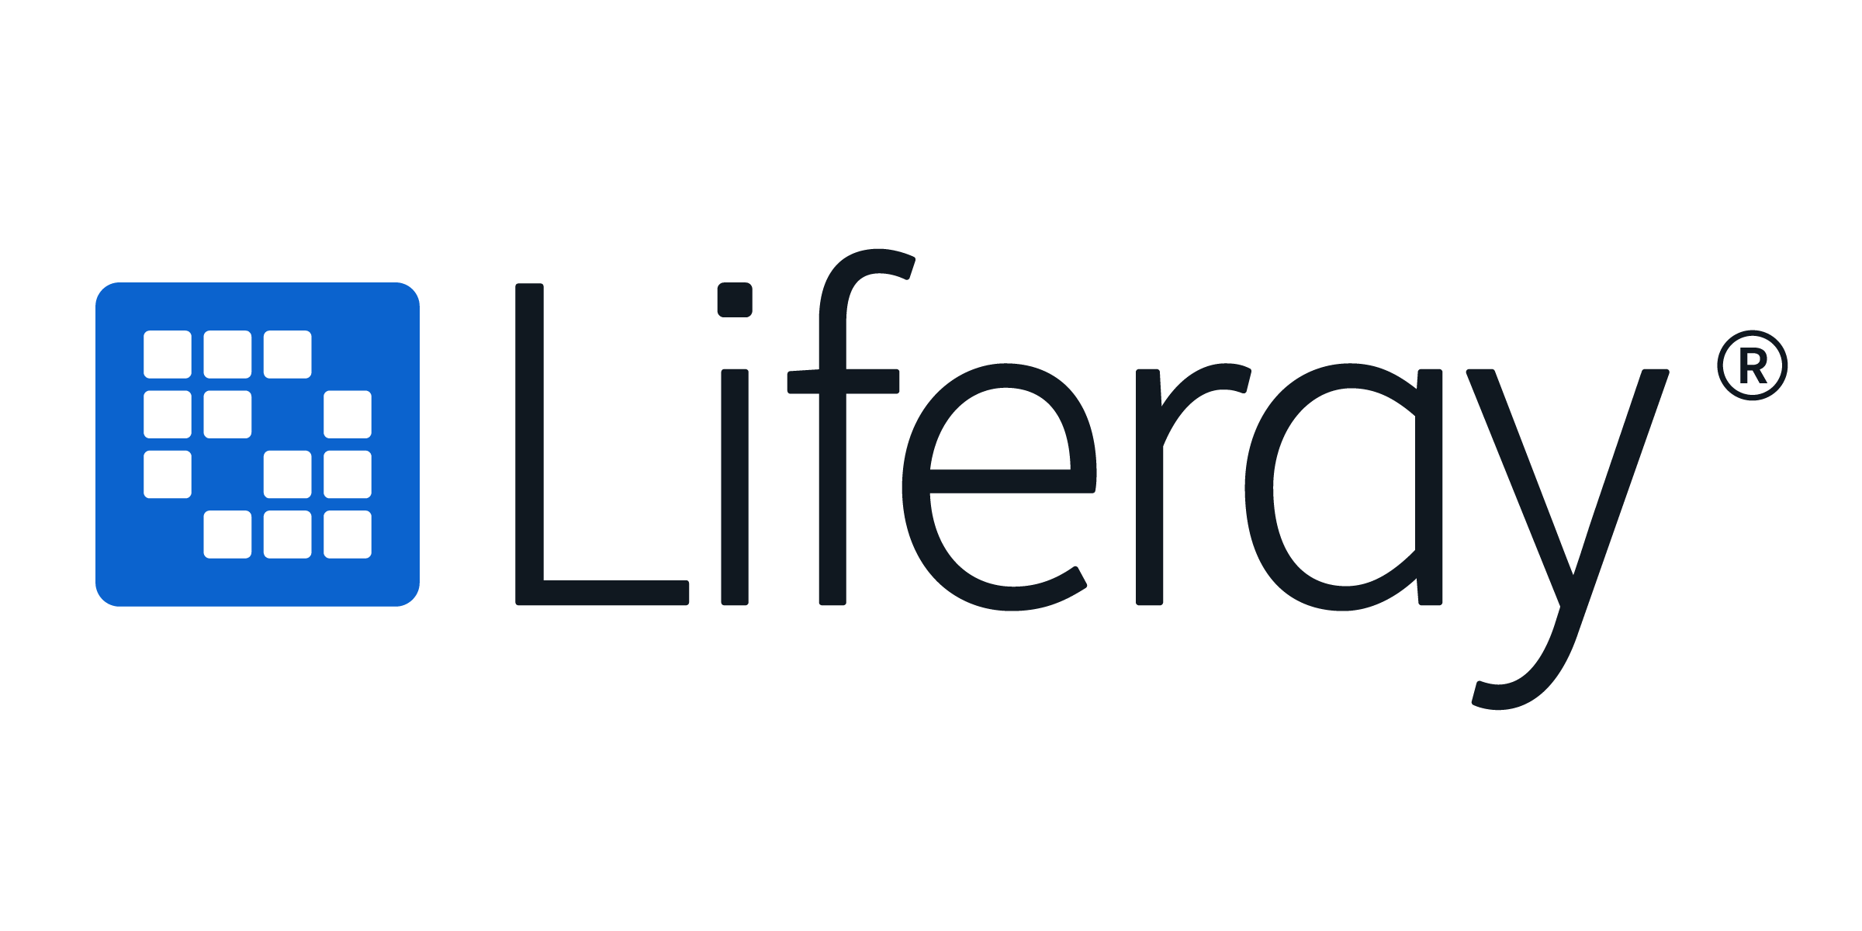

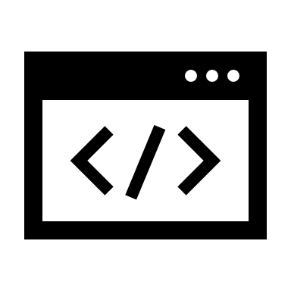


How CMS Works
Energy Portal
Admin / Content Managers
Full Rights
Site Visitors
Content Publishers/
Contributors
Limited Rights
Editors
Moderate Rights
Approvers
Moderate Rights
Notes:
In general, a CMS (Content Management System) consists of two elements: the content management application (Content Management Application, [CMA]) content delivery application (Content Delivery Application [CDA]). The CMA element allows the content manager may not have knowledge of HTML, to manage the creation, modification, and deletion of content from a Web site without the need to have expertise as a Webmaster.

Slide 10
LIFERAY DXP

Slide 11
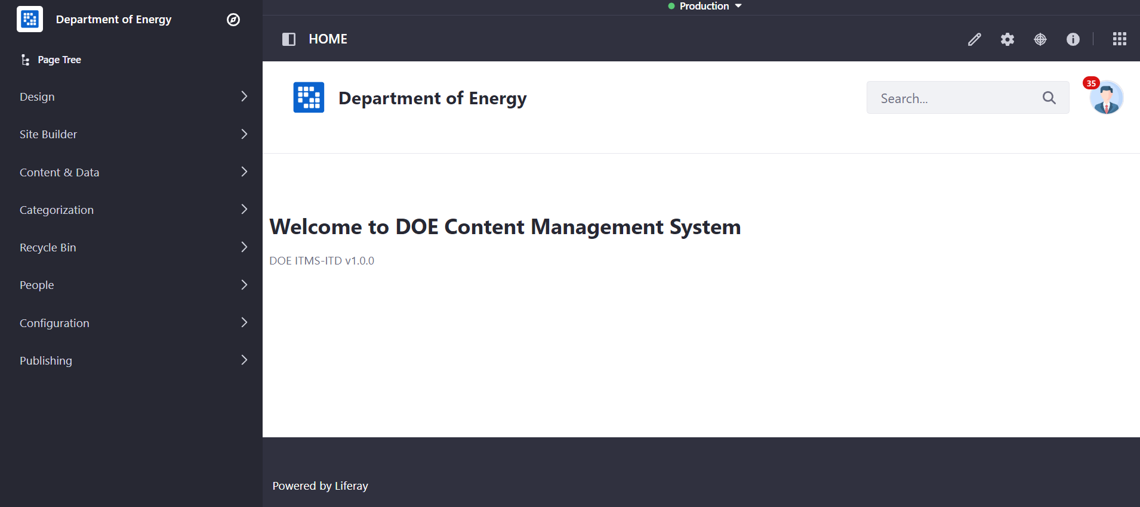
Liferay DXP
Liferay DXP is a powerful and enterprise-ready platform for building and deploying web applications and content. With Liferay Objects, you can build and deliver applications and content without having to write code or deploy modules.
Notes:
Liferay DXP is a powerful and enterprise-ready platform for building and deploying web applications and content. However, all of that power and functionality can make it difficult to know where to start. This section walks you through some of the basics of getting an instance up and running on your own local machine, explains the Liferay user interface, and get you started with creating your first site.

Slide 12
Introduction to Admin Account
The Admin User account is created by default in your Portal’s new installation of Liferay and has full permissions to modify every facet of a DOE Portal instance.
The Admin User can create, modify, and delete Sites, Users, and pages, and perform all Site administrative tasks.
CMS Site: https://doe-filmetrics.com/
Admin Account: user@liferay.com
Password: 5h3O81ap59XG4780

Slide 13
ADMIN ACCOUNT

Slide 14
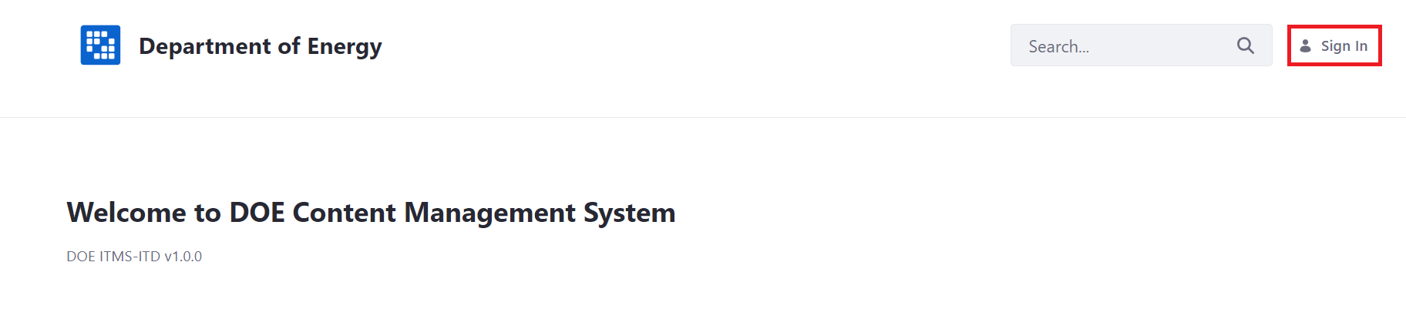
Accessing Liferay as the Admin User
Open a browser to https://doe-filmetrics.com/
Click the Sign In link
Enter the default admin credentials to login.

Slide 15
Accessing Liferay as the Admin User
WARNING!
It is highly recommended that the default login credentials be updated when the system has been turned over to DOE.

Slide 16
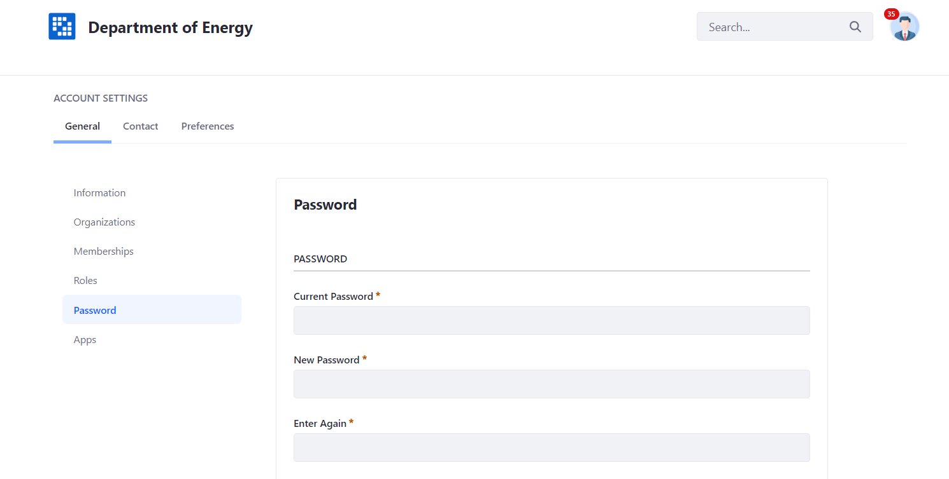
Configuring the Admin User
Changing the Login Password
Click the User Avatar and navigate to Account Settings → Password.
Enter your Current Password and provide a new password.

Slide 17
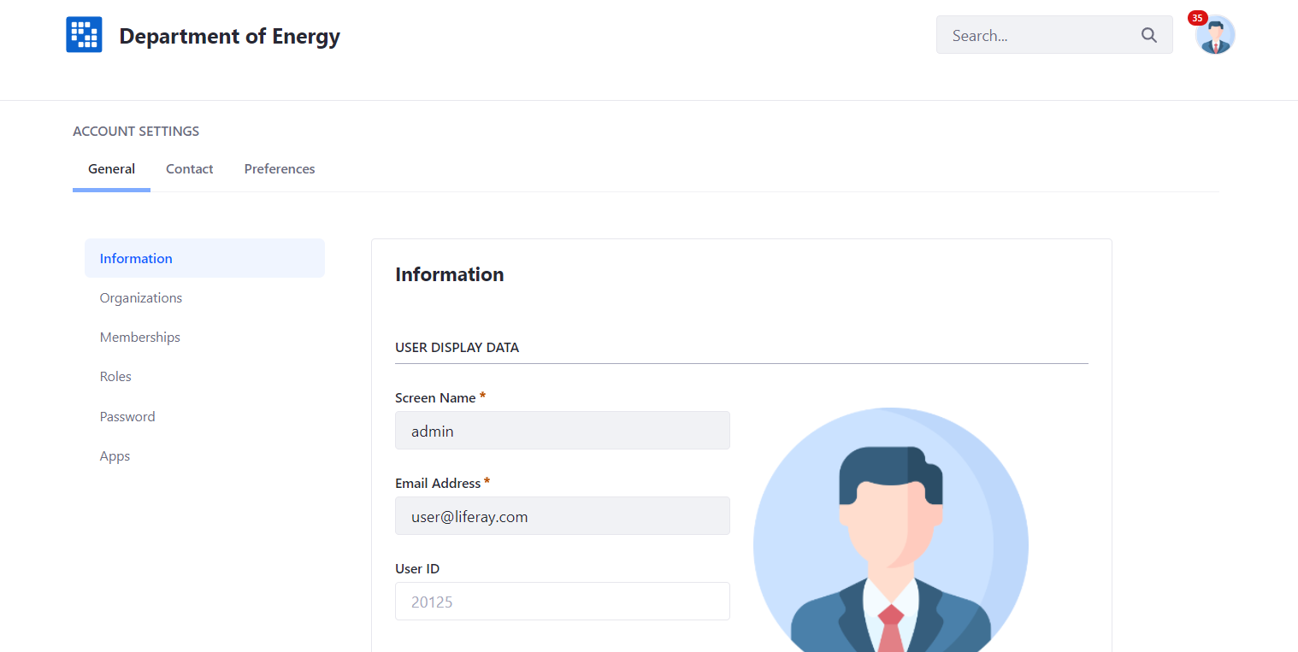
Configuring the Admin User
Changing Account Information
Click the User Avatar and navigate to Account Settings
In the Information tab, change or add User information as needed.

Slide 18
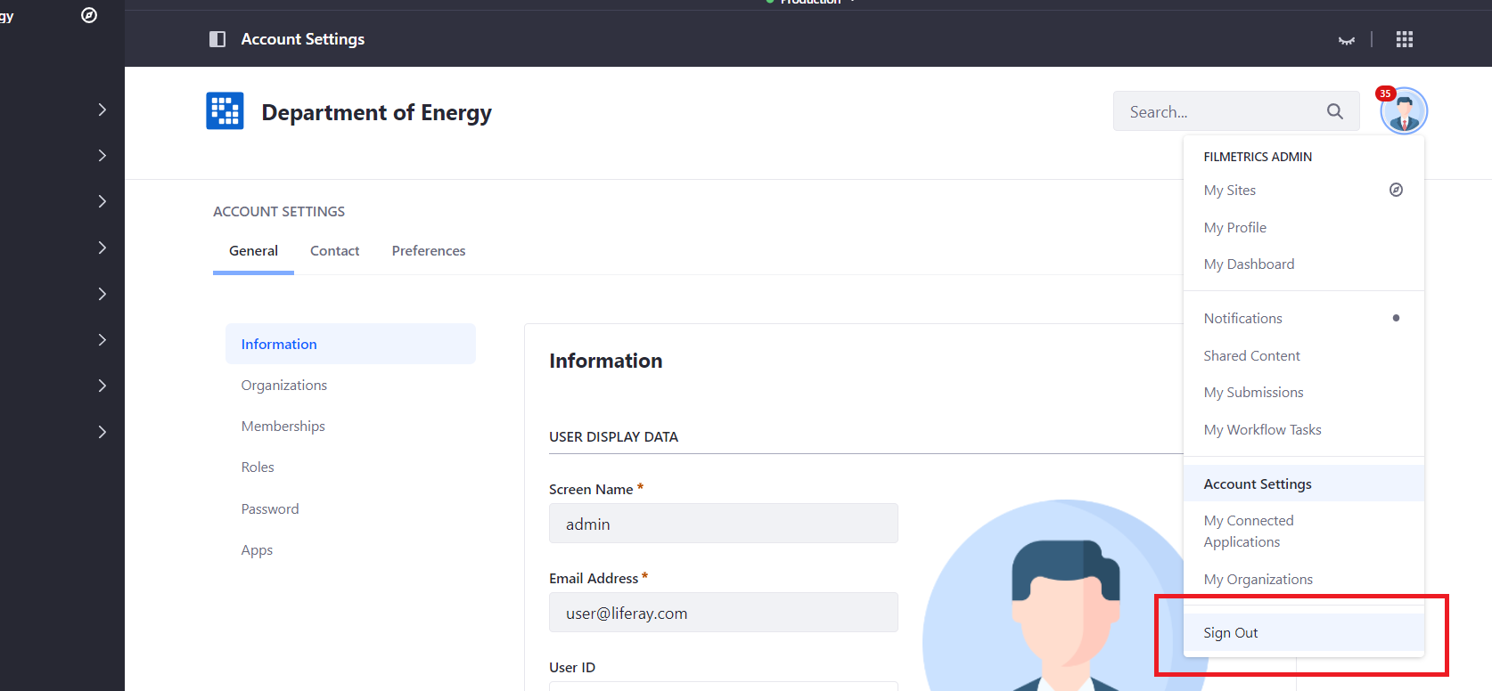
Signing Out
Signing Out
Click User Avatar → Sign Out.
Notes:
To log out of your account:
Click User Avatar → Sign Out.

Slide 19
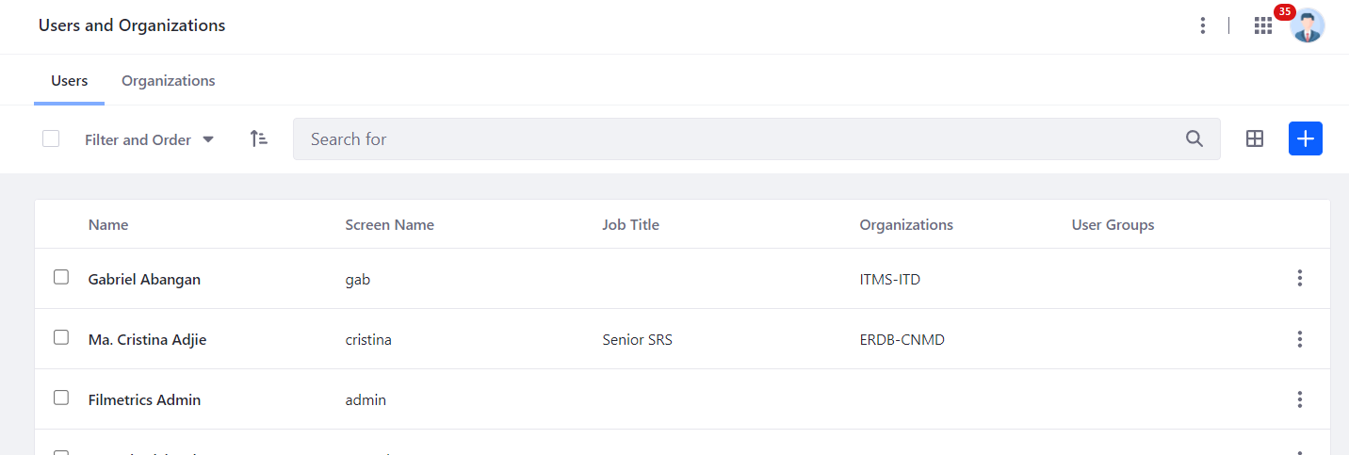
Adding and Managing Users
From the Product Menu, click Control Panel → Users → Users and Organizations.
In the Users tab, click the Add button.
Fill out the Add User form and click Save. At a minimum, provide a Screen Name, First Name, Last Name, and Email Address for the User.
Notes:
Now that you know how to log in, we strongly recommend that you create a new admin User for everyday use.
Core user management activities include adding, editing, and deleting users. These activities are typically restricted to Administrative users.
To create a new admin account or a new user account follow these steps:
Once you create the User, additional information can be added.

Slide 20
Adding and Managing Users
NOTE
Screen names and email addresses are not interchangeable. A screen name cannot contain an @ symbol because it is used in the URL to a User’s pages.
The Add User functionality is split over several independent forms. Save the first form to create the User, and then you’ll see a success message saying Success: “Your request completed successfully.”

Slide 21
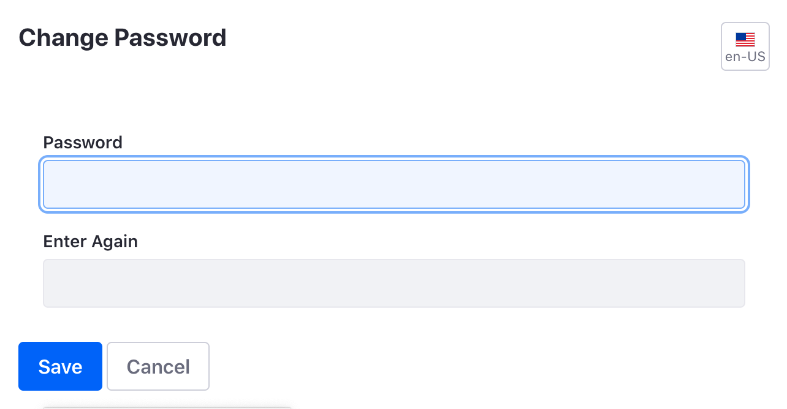
Setting Passwords for New Users
When you create a User, Liferay generates his/her password. If a mail server was set up, Liferay sends an email message with the User’s new password.
If you haven’t set up a mail server, click the Password item from the General menu and manually set a password for your new user. Enter the new password twice.
Notes:
Now that you know how to log in, we strongly recommend that you create a new admin User for everyday use.
Core user management activities include adding, editing, and deleting users. These activities are typically restricted to Administrative users.
To create a new admin account or a new user account follow these steps:
Once you create the User, additional information can be added.

Slide 22
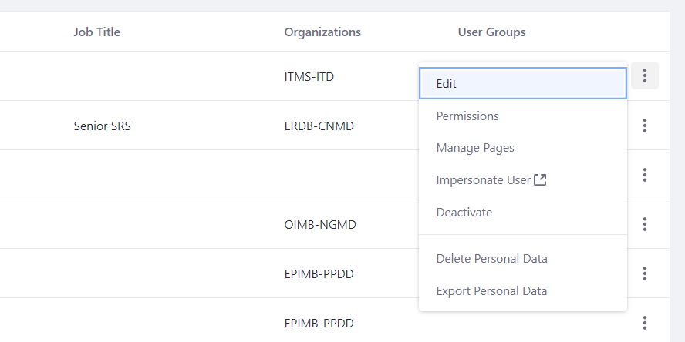
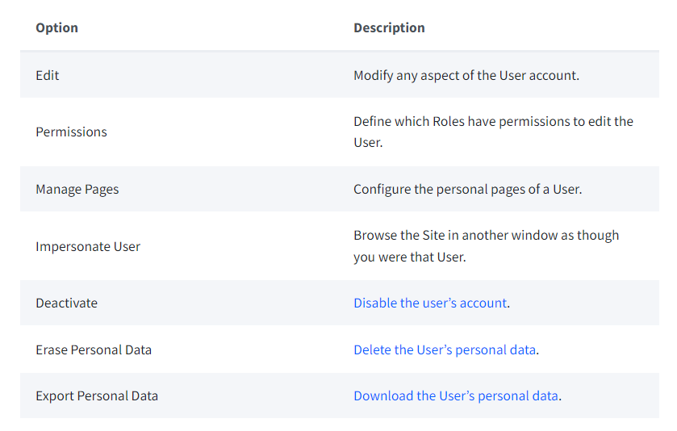
Admin Actions
The following options are available:

Slide 23
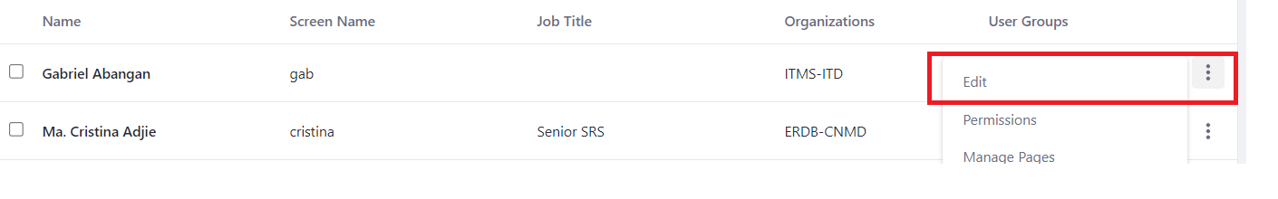
Editing Users
Click on Users and Organizations in the Control Panel
Click the Actions button next to that user to edit.
Notes:
Now that you know how to log in, we strongly recommend that you create a new admin User for everyday use.
Core user management activities include adding, editing, and deleting users. These activities are typically restricted to Administrative users.
To create a new admin account or a new user account follow these steps:
Once you create the User, additional information can be added.

Slide 24
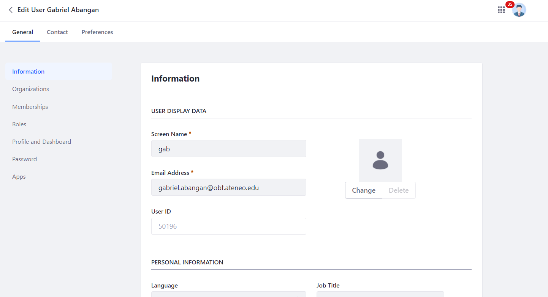
Editing Users

Slide 25
Deactivating Users
Navigate to Control Panel → Users → Users and Organizations to locate the User to deactivate.
Click the Actions menu for the User and select Deactivate.
The User is now deactivated and can no longer log in. Users can be reactivated by finding them in the Users table, clicking the Actions menu, and selecting Activate. There’s no confirmation window for activation: they’re automatically restored to their former status once Activate is clicked.
Notes:
Deactivating a User prevents the user from logging in, but preserves the User. You can toggle between active and inactive Users in the Users view. If all the Users are active, this filtering option doesn’t appear.
The User is now deactivated and can no longer log in. Users can be reactivated by finding them in the Users table (be sure you’re filtering the table results by Deactivated users), clicking the Actions menu, and selecting Activate. There’s no confirmation window for activation: they’re automatically restored to their former status once Activate is clicked.

Slide 26
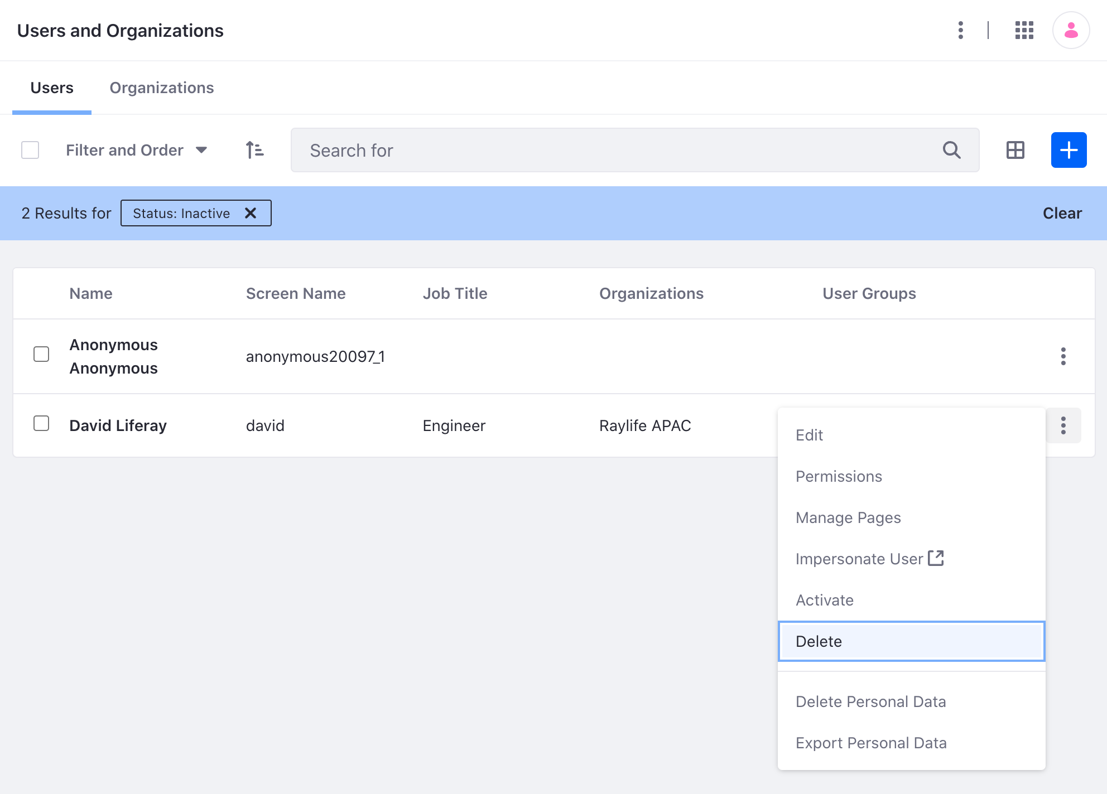
Deleting Users
Deactivate the user.
Click on Filter and order in the top of the table and a selector appears. Click Inactive, and you can see the User you just deactivated.
Click the Actions menu again, and click Delete if you really mean to delete the User.
Notes:
To guard against accidental deletion of Users, users must be deactivated first, and then can be deleted.
<Steps>
The user is deleted. There is no way to recover the User once deleted besides restoring from a prior backup.

Slide 27
Deleting Users
WARNING!
There is no way to recover the User once deleted besides restoring from a prior backup.

Slide 28
Impersonating Users
Click Control Panel → Users and Organizations to see the list of Users and find the one you want to impersonate.
Click that User’s Actions button (Actions).
Click Impersonate User.
This opens another browser window logged in as that User.
Notes:
You can impersonate Users to view the system as the User would see it. This helps to diagnose permission issues an administrator can’t see, such as making sure a User doesn’t have access to sensitive data. Only Users with the Administrator Role can impersonate.

Slide 29
Resetting a User Password
Navigate to Password Policies in Control Panel → Users.
Click on the Default Password Policy.
De-select the Change Required switcher in the Password Changes section. Now you can decide whether users you add must reset their passwords.
See Liferay’s Password Policies for more information on editing the default policy or creating your own.
Notes:
The Add User functionality includes a Require Password Reset check box at the bottom of the Password form. The default password policy prevents administrators from de-select this option. You can, however, modify the default password policy so this box becomes usable.
Now that we have a new user, which is now a portal administrator. Log out and then log back in with your new User account. What’s Next?

Slide 30
QUESTIONS?

Slide 31
NAVIGATING LIFERAY
Notes:
<Open Liferay and Discuss Notes>

Slide 32
CREATING A NEW
CHILD PORTAL
Notes:
<Open Liferay and Discuss Notes>

